Slide 1
Functional Enrichment Analysis & Candidate Gene Ranking
Anil Jegga
Biomedical Informatics
Contact Information:
Anil Jegga
Biomedical Informatics
Room # 232, S Building 10th Floor
CCHMC
Homepage: http://anil.cchmc.org
Tel: 513-636-0261
E-mail: anil.jegga@cchmc.org

Slide 2
Slides and Example data sets available for download at:
http://anil.cchmc.org/dhc.html
Workshop Evaluation: Please provide your valuable feedback on the evaluation sheet provided along with the hand-outs
This workshop is about the analysis of transcriptome (identifying enriched biological processes, etc.) and ranking or prioritizing candidate genes. It does not cover microarray data analysis.
Contact Huan Xu (huan.xu@cchmc.org for GeneSpring related questions or microarray data analysis.
All the applications/servers/databases used in this workshop are free for academic-use. Applications that are not free for use (e.g., Ingenuity Pathway Analysis, etc.) are not covered here. However, we have licensed access to use some of these and please contact us if you are interested in using them.

Slide 3
What are we going to cover today?
Gene List Functional Enrichment Analysis
Multiple Gene Lists Functional Enrichment Analysis
Prioritizing or Ranking Candidate Genes
Based on functional annotations
Based on network connectivity
ToppGene Suite: http://toppgene.cchmc.org
ToppCluster: http://toppcluster.cchmc.org

Slide 4
Related Publications
(for methodology- and validation-related details)
ToppGene Suite
Chen J, Xu H, Aronow BJ, Jegga AG. 2007. Improved human disease candidate gene prioritization using mouse phenotype. BMC Bioinformatics 8:392.
Chen J, Aronow BJ, Jegga AG. 2009. Disease candidate gene identification and prioritization using protein interaction networks. BMC Bioinformatics 10:73.
Chen J, Bardes EE, Aronow BJ, Jegga AG 2009. ToppGene Suite for gene list enrichment analysis and candidate gene prioritization. Nucleic Acids Research doi: 10.1093/nar/gkp427.
ToppCluster
Kaimal V, Bardes E, Jegga AG, Aronow BJ. 2010. ToppCluster: a multiple gene list feature analyzer for comparative enrichment clustering and network-based dissection of biological systems. Nucleic Acids Research (in press).

Slide 5
I have a list of co-expressed mRNAs (Transcriptome)….
Now what?
Identify putative shared regulatory elements
Identify the underlying biological theme
Known transcription factor binding sites (TFBS)
Conserved
Non-conserved
Unknown TFBS or Novel motifs
Conserved
Non-conserved
MicroRNAs
Gene Ontology
Pathways
Phenotype/Disease Association
Protein Domains
Protein Interactions
Expression in other tissues/experiments
Drug targets
Literature co-citation…

Slide 6
Annotation Databases
Gene Ontology, Pathways
Genome-wide Promoters
Putative Regulatory Signatures
Expression Profile - Gene Lists
DNA Repair
XRCC1
OGG1
ERCC1
MPG…..
E2F
RB1
MCM4
FOS
SIVA…..
Angiogenesis
HIF1A
ANGPT1
VEGF
KLF5….
PDX1
GLUT2
PAX4
PDX1
IAPP….
p53
CDKN1A
CTSD
CASP
DDB2….
Gene lists associated with similar function/process/pathway
P53
CTSD
CASP
DDB2….
E2F
RB1
MCM4
FOS…
Enrichment Analysis
DNA Repair
XRCC1
OGG1
ERCC1
MPG….
Angiogenesis
HIF1A
ANGPT1
VEGF…..
Expected
Observed
Random Distribution
Significant Enrichment

Slide 7
I have a list of co-expressed mRNAs (Transcriptome)….
I want to find the shared cis-elements – Known and Novel
Known transcription factor binding sites (TFBS)
Conserved
oPOSSUM
DiRE
Non-conserved
Pscan
MatInspector (*Licensed)
Unknown TFBS or Novel motifs
Conserved
oPOSSUM
Weeder-H
Non-conserved
MEME
Weeder
Each of these applications support different forms of input. Very few support probeset IDs.
Red Font: Input sequence required; Do not support gene symbols, gene IDs, or accession numbers. The advantage is you can use them for scanning sequences from any species.
*Licensed software: We have access to the licensed version.
Covered in the last workshop (Sept. 2009).
Will not be covered today.
Training material is available on-line.

Slide 8
I have a list of co-expressed mRNAs (Transcriptome)….
Identify the underlying biological theme
What are my genes “enriched” for?
Gene Ontology
Pathways
Phenotype/Disease Association
Protein Domains
TFBS and microRNA
Protein Interactions
Expression in other tissues/experiments
Drug targets
Literature co-citation…

Slide 9
ToppGene Suite (http://toppgene.cchmc.org)
Free for use, no log-in required.
Web-based, no need to install anything (except for applications to visualize or analyze networks)
Validated and published

Slide 10
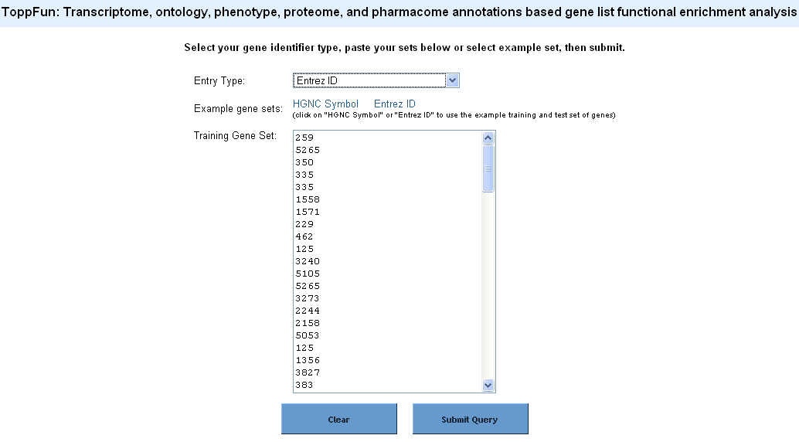
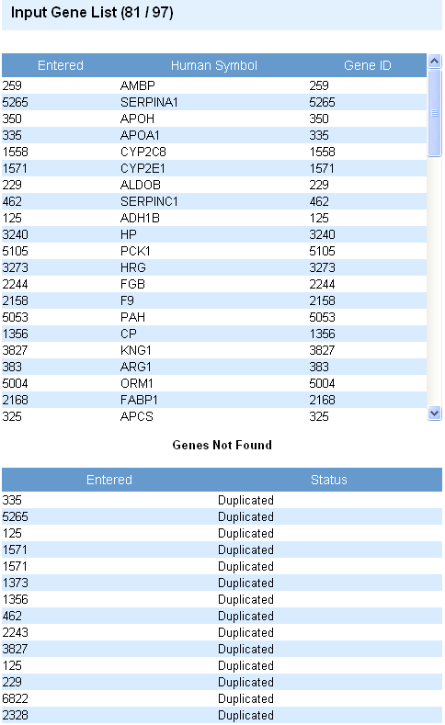
ToppGene Suite (http://toppgene.cchmc.org) - ToppFun
Supports variety of inputs
Supports symbol correction
Eliminates any duplicates
Drawback: Supports human and mouse genes only

Slide 11
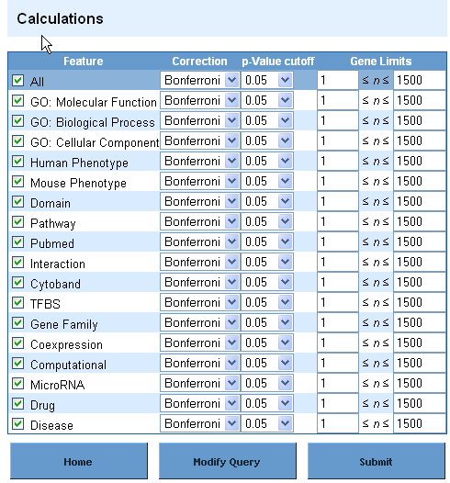
ToppGene Suite (http://toppgene.cchmc.org) - ToppFun
Gene list analyzed for as many as 17 features!
Single-stop enrichment analysis server for both regulatory elements (TFBSs and miRNA) and biological themes
Back-end has an exhaustive, normalized data resources compiled and integrated
Bonferroni correction is “too stringent”; FDR with 0.05 is preferable.
TFBS are based on conserved cis-elements and motifs within ±2kb region of TSS in human, mouse, rat, and dog.
miRNA-targets are based on TargetScan, PicTar and miRrecords/Tarbase.

Slide 12
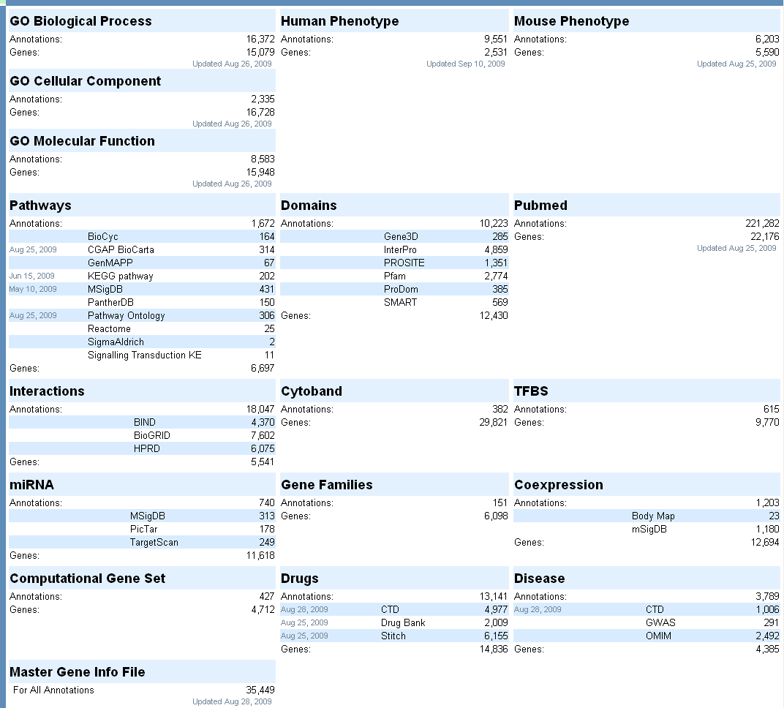
ToppGene Suite (http://toppgene.cchmc.org)
Database updated regularly
Exhaustive collection of annotations

Slide 13
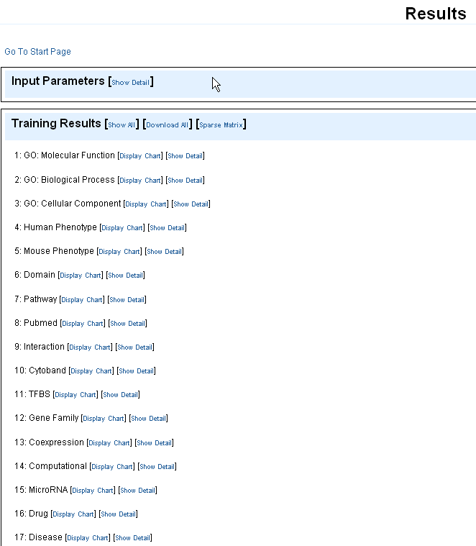
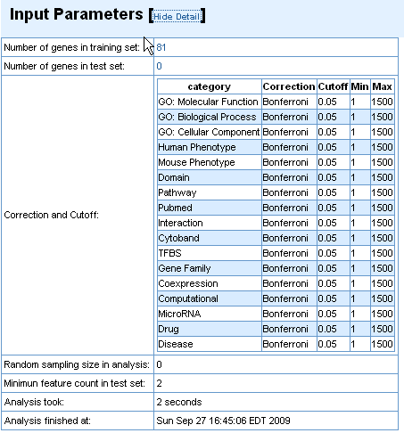
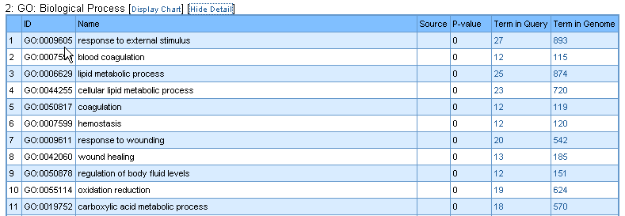
ToppGene Suite (http://toppgene.cchmc.org) - ToppFun

Slide 14
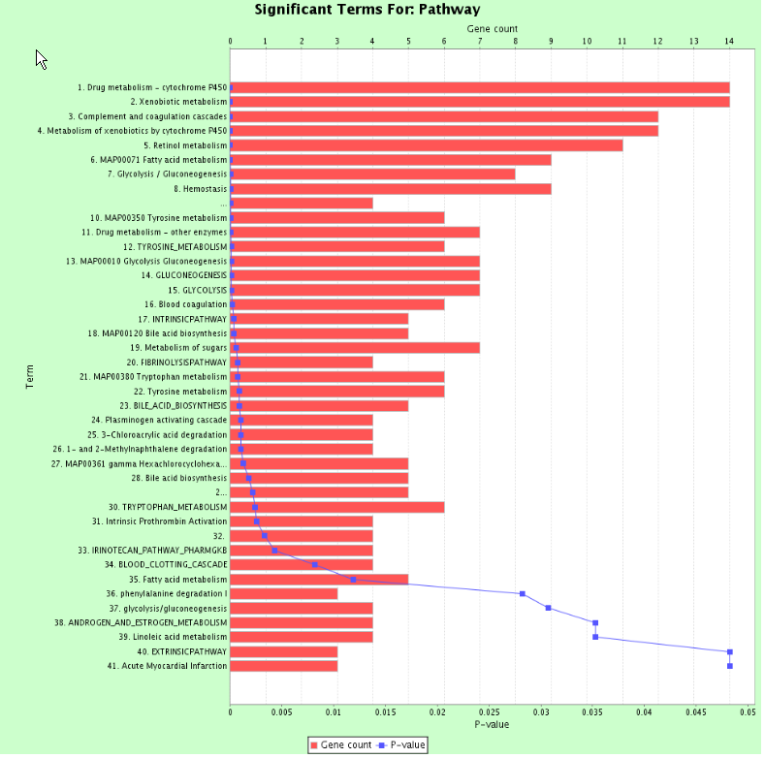
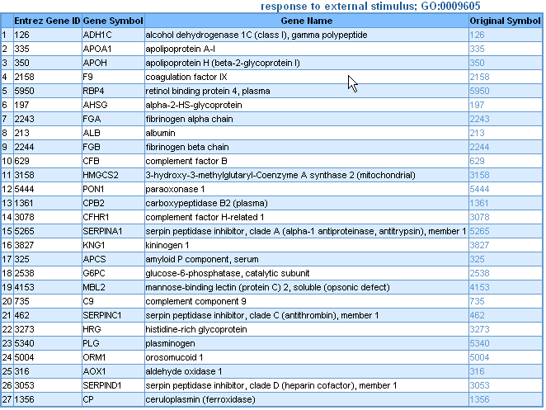
ToppGene Suite (http://toppgene.cchmc.org) - ToppFun

Slide 15
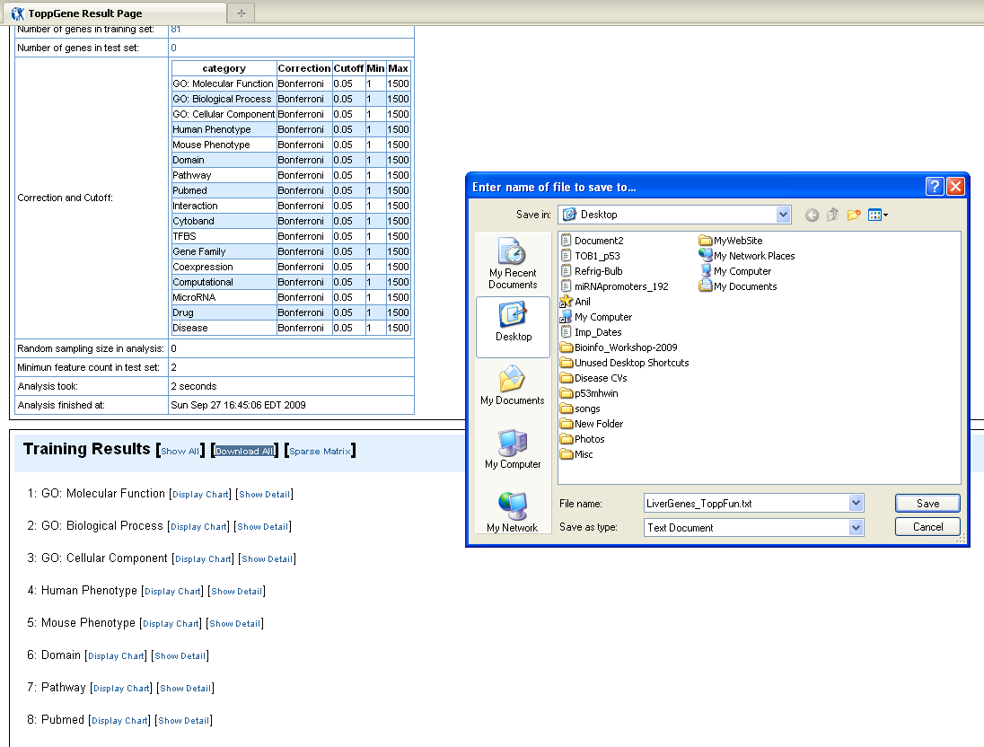
ToppGene Suite (http://toppgene.cchmc.org) - ToppFun

Slide 16
Download Example Data Sets for Exercises From
http://anil.cchmc.org/dhc.html
Two Excel Files:
GeneLists.xls: Has two worksheets
Tissue_GeneLists: Has a list of overexpressed genes in some of the digestive system tissues
miRNA-Targets_Validated: Has a list of validated target genes for some of the microRNAs
CandidateGenes.xls: Has two worksheets
abnormal_dig_sys_morph_genes: Has a list of genes associated with the phenotype abnormal digestive system morphology in mouse
miRNA_Putatitve_Targets: Has a list of predicted targets of some of the miRNAs from TargetScan (version 5.0)

Slide 17
Exercise 1: Use the different gene lists from the downloaded file (“GeneLists.xls”) and find out:
Note: The “GeneLists.xls” file has two worksheets and within each worksheet there are several gene lists based on tissue-specificity or being microRNA targets (validated)
How many of the liver-overexpressed genes are associated with lipid metabolic process?
Are there any enriched TFBSs for liver overexpressed genes?
What are the enriched miRNAs in the colon-cecum overexpressed genes?
What gene families are enriched in esophagus overexpressed genes?
In which other regions are stomach (cardiac) genes overexpressed?
What biological process are miR-1 target genes enriched for?

Slide 18
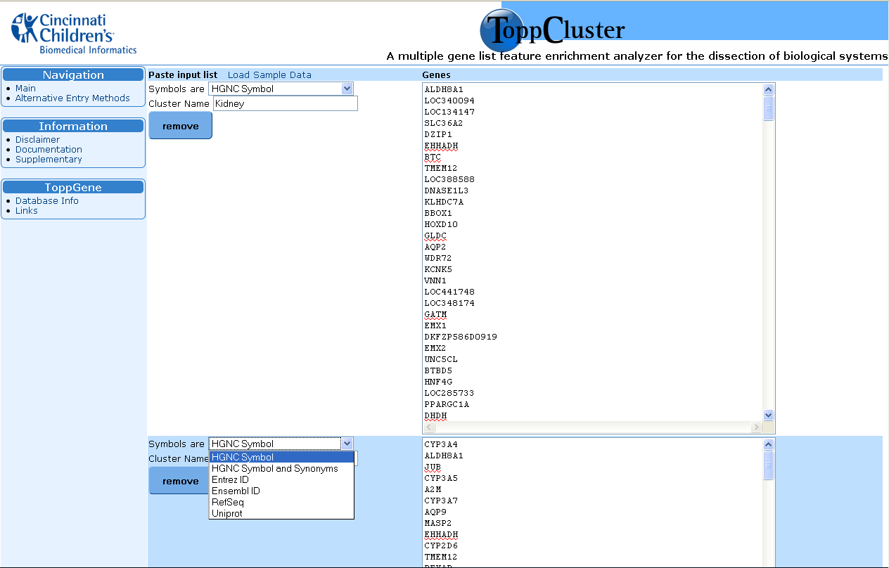
What if I want to compare several gene lists at a time?
ToppCluster (http://toppcluster.cchmc.org)

Slide 19
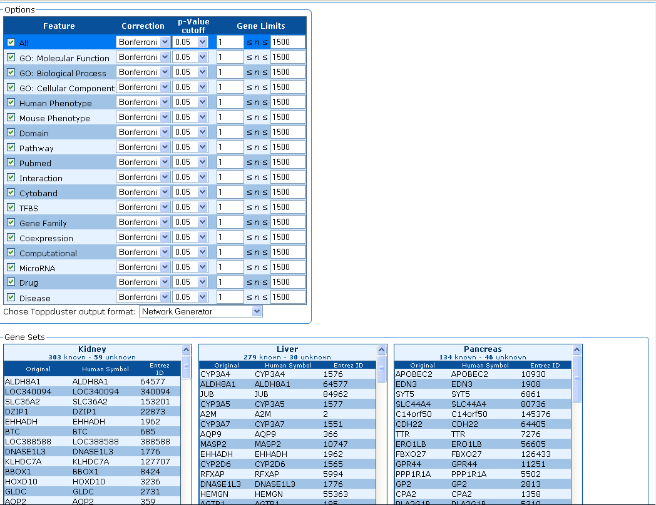
ToppCluster (http://toppcluster.cchmc.org)

Slide 20
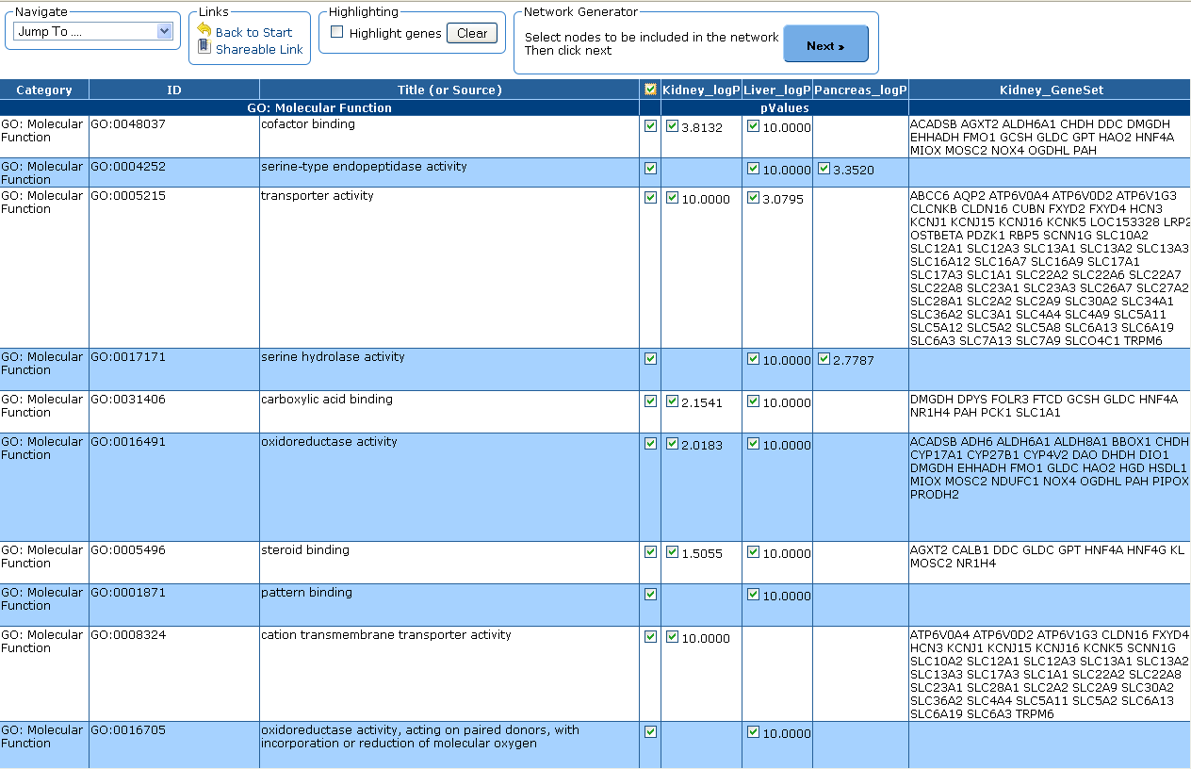
ToppCluster (http://toppcluster.cchmc.org)

Slide 22
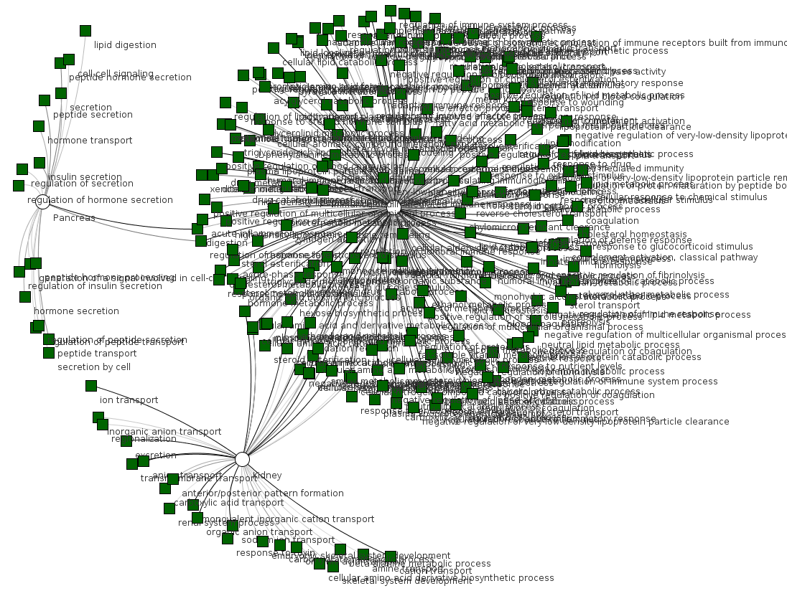
ToppCluster (http://toppcluster.cchmc.org)

Slide 23
ToppCluster (http://toppcluster.cchmc.org)
Cytoscape (http://cytoscape.org)
Should be installed on your computer and the downloaded files should be imported into these applications
Gephi (http://gephi.org)

Slide 24
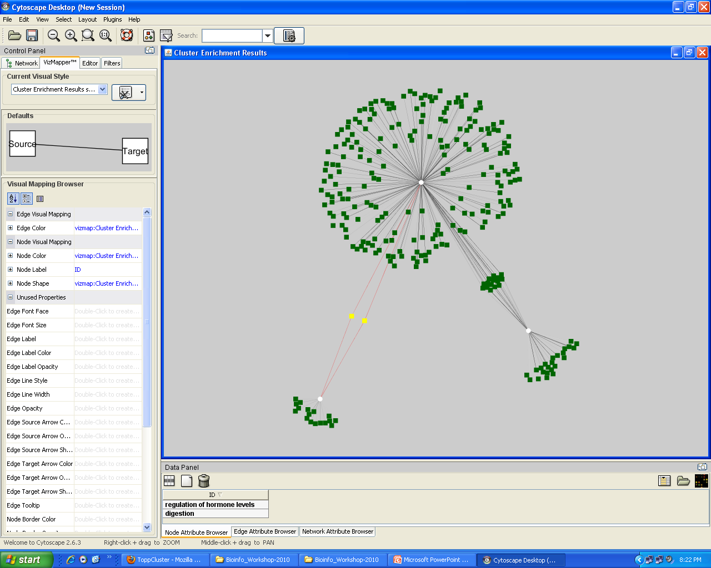
Cytoscape Network (Abstract View)

Slide 25
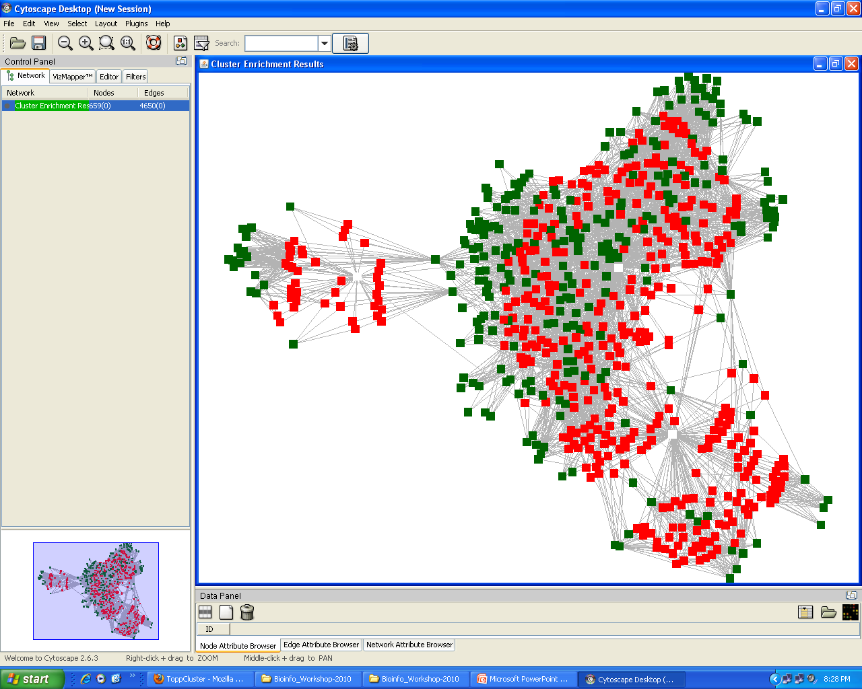
Cytoscape Network (GeneLevel View)

Slide 26
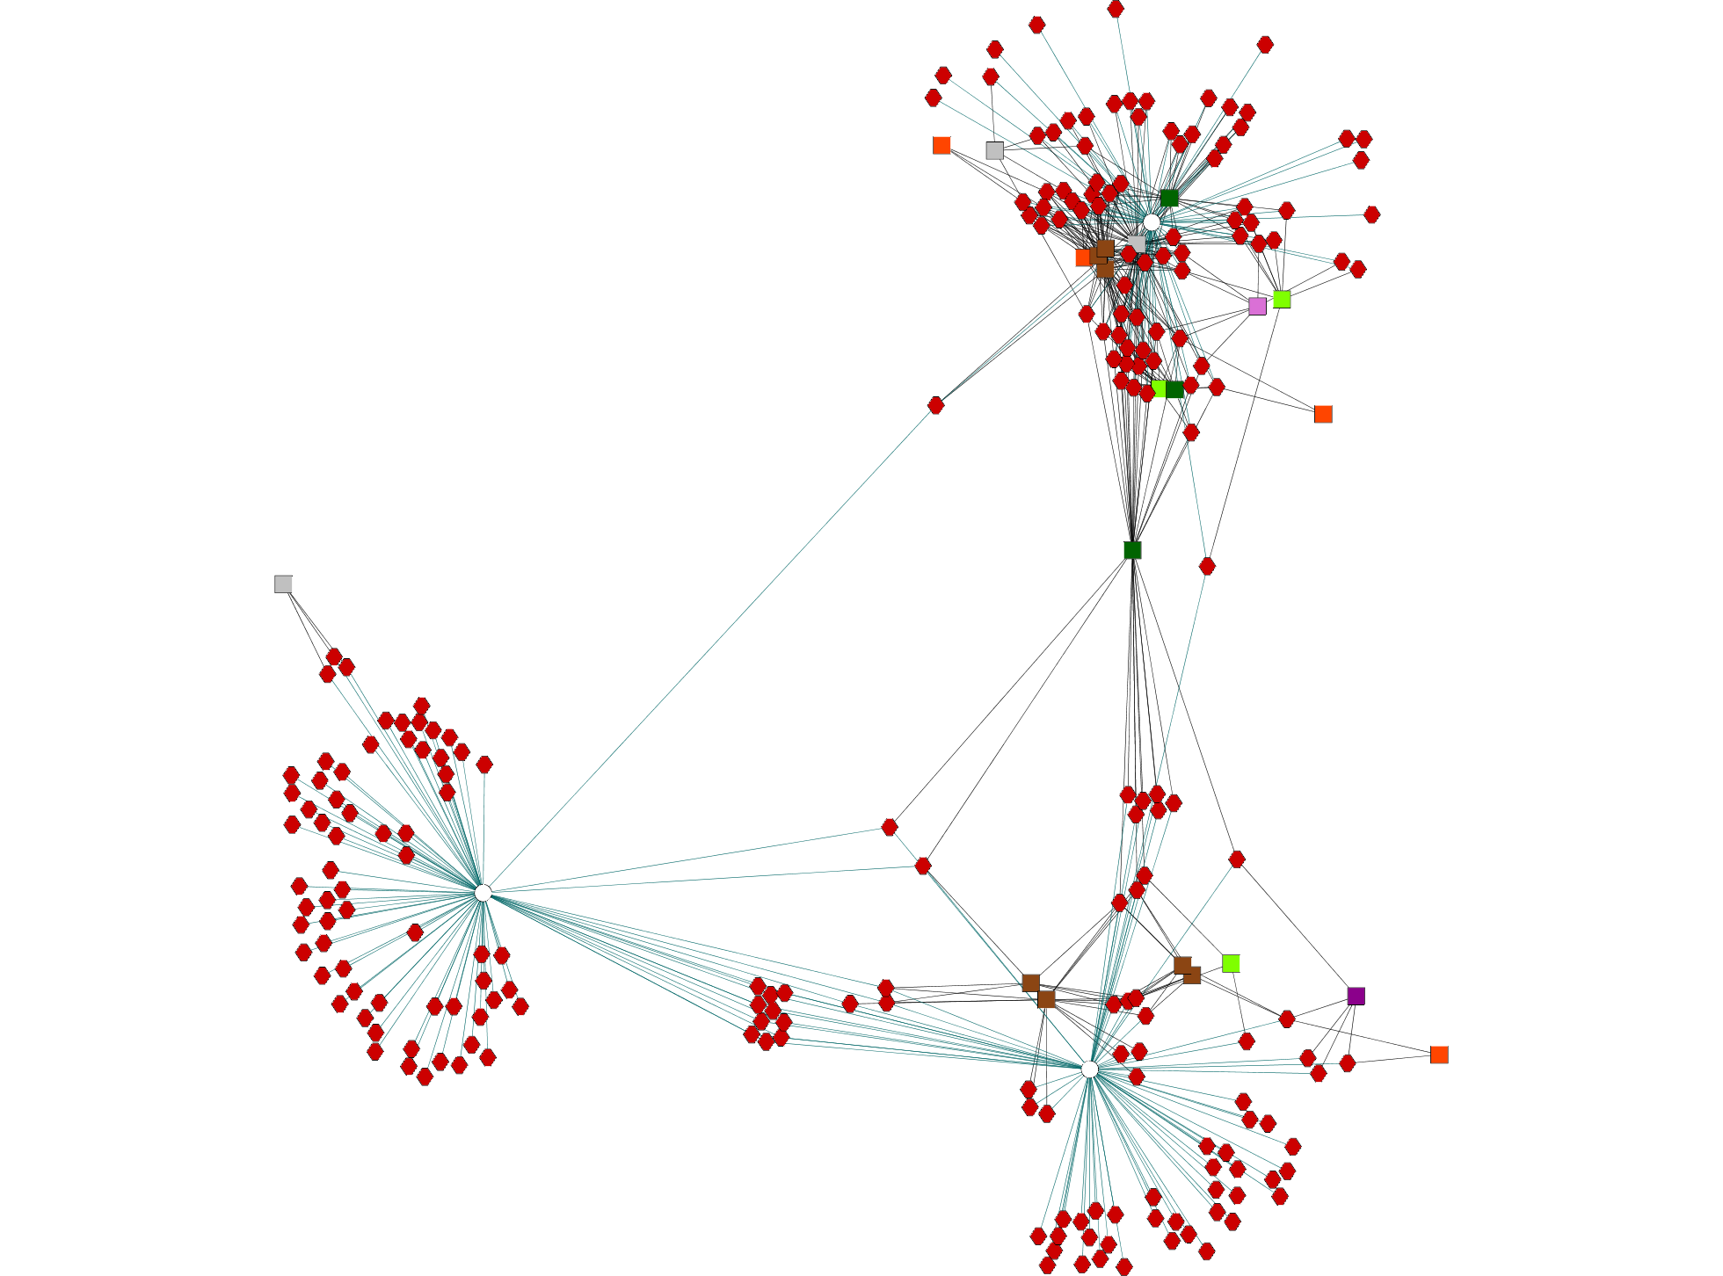
Cytoscape Network (GeneLevel View)
EHF
COL15A1
LOC100130100
IGHA1
LTF
IGKC
IGL@
FAM129A
ATP8B1
IGLC2
Network View – Shared and specific genes and annotations between different gene lists
Cytoscape (http://cytoscape.org) installation required
V$HNF1
Liver
abnormal gastric mucosa morphology
abnormal stomach morphology
abnormal digestive secretion
abnormal digestive system physiology
Salivary Gland
Stomach

Slide 27
Exercise 2: Use the different gene lists from the downloaded file (“GeneLists.xls”) and find out:
Note: The “GeneLists.xls” file has two worksheets and within each worksheet there are several gene lists based on tissue-specificity or being microRNA targets (validated)
What are the shared and specific biological processes between stomach and salivary glands?
Are there any enriched miRNAs for stomach? If so, which other tissues are enriched for this miRNA?
What are the functional similarities and differences between the 3 regions of the stomach (cardiac, fundus, and pylorus)?

Slide 28
ToppGene Suite (http://toppgene.cchmc.org)
I have a list of 200 over-expressed genes and I want to prioritize them for experimental validation (apart from using the fold change as a parameter)…..

Slide 29
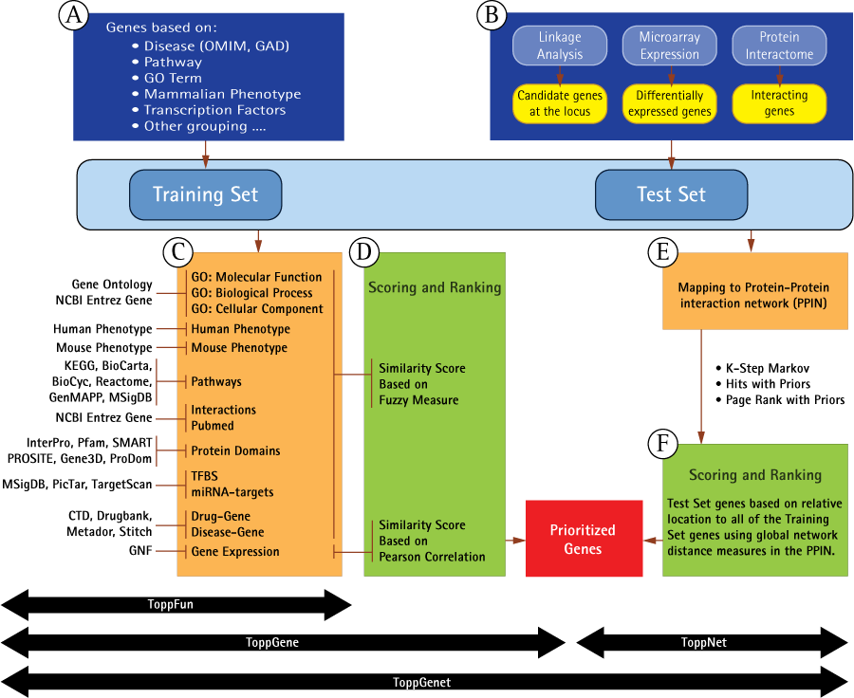
ToppGene Suite (http://toppgene.cchmc.org) - ToppGene
I have a list of 200 over-expressed genes and I want to prioritize them for experimental validation (apart from using the fold change as a parameter)…..

Slide 30
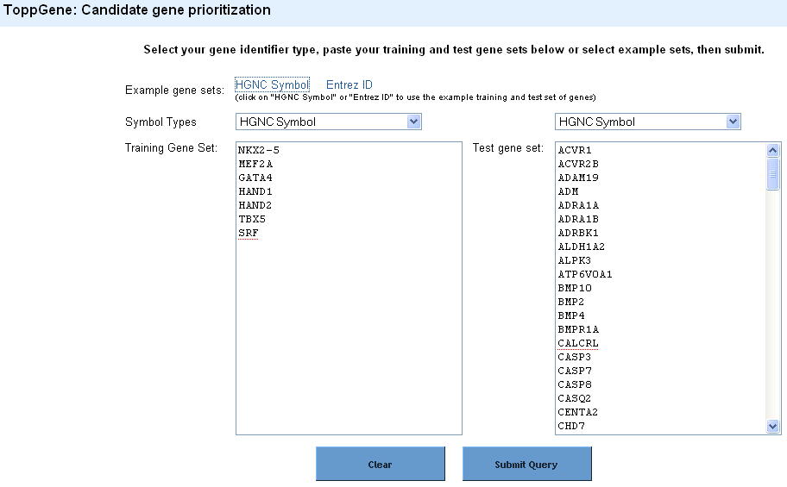
ToppGene Suite (http://toppgene.cchmc.org) - ToppGene

Slide 31
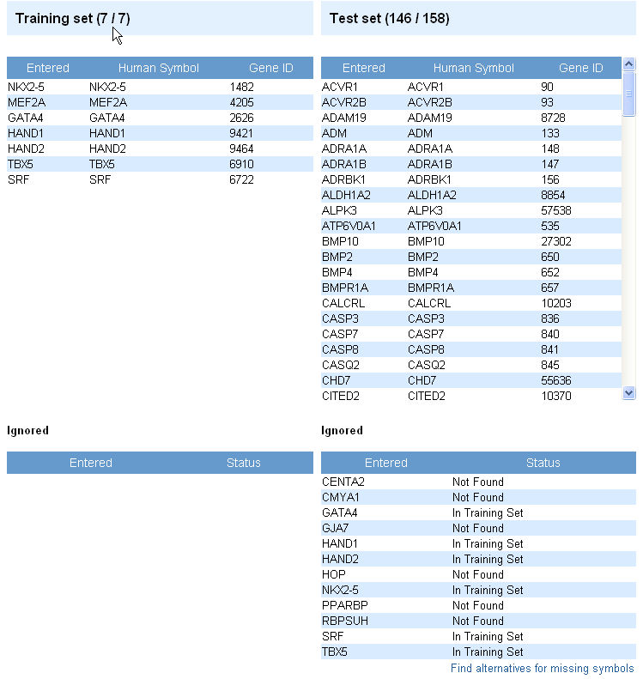
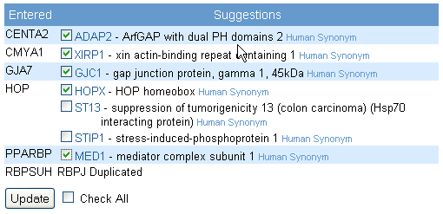
ToppGene Suite (http://toppgene.cchmc.org) - ToppGene

Slide 32
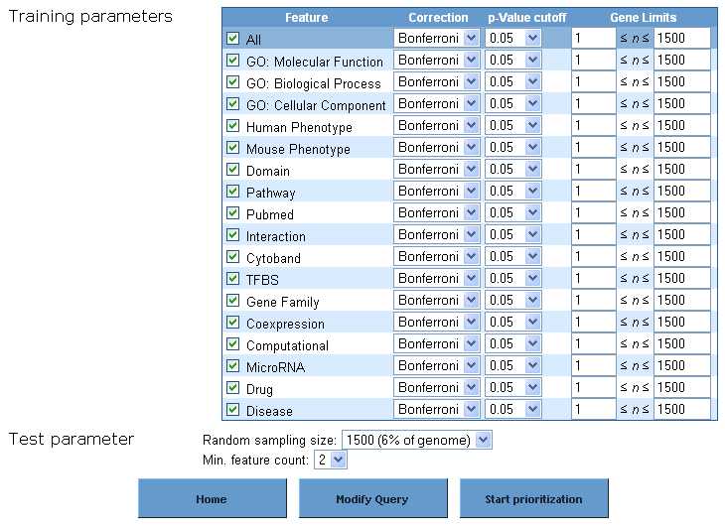
ToppGene Suite (http://toppgene.cchmc.org) - ToppGene

Slide 33
ToppGene Suite (http://toppgene.cchmc.org) - ToppGene

Slide 34
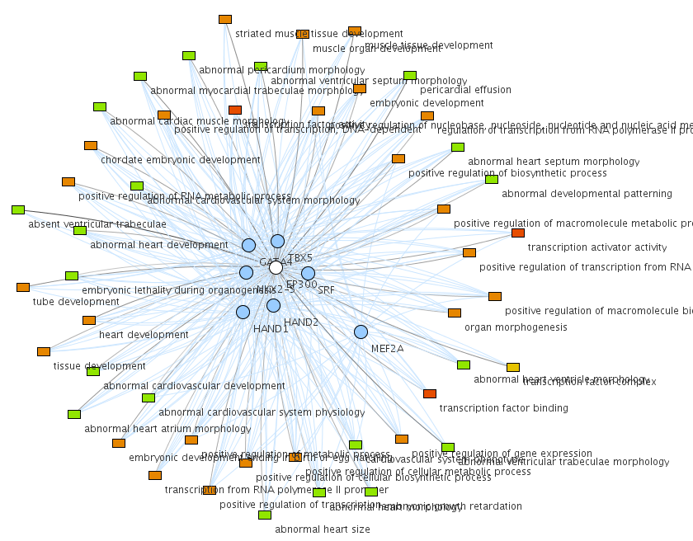
ToppGene Suite (http://toppgene.cchmc.org) - ToppGene
Why is a test set gene ranked higher?

Slide 35
ToppGene Suite (http://toppgene.cchmc.org) - ToppNet
I have a list of 200 over-expressed genes and I want to prioritize them for experimental validation (apart from using the fold change as a parameter)…..

Slide 36
ToppGene Suite (http://toppgene.cchmc.org) - ToppNet

Slide 37
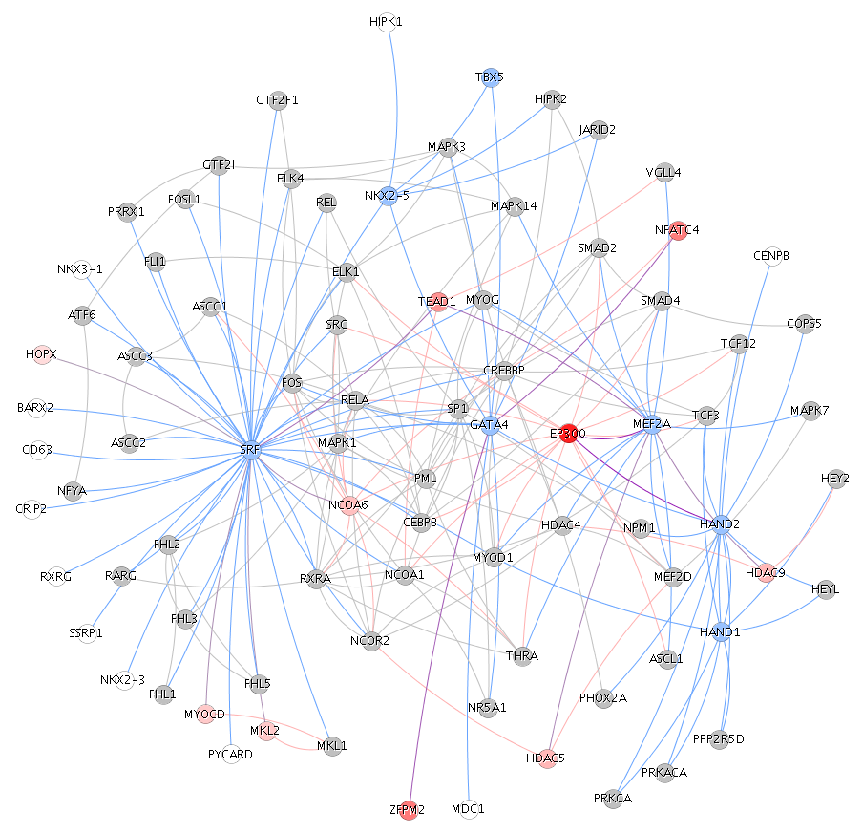
ToppGene Suite (http://toppgene.cchmc.org) - ToppNet

Slide 38
Exercise 3: Prioritize the 721 genes (“CandidateGenes.xls”) using “stomach genes” from the “GeneLists.xls”.
What are the top 10 ranked genes using ToppGene and ToppNet?
What is the rank of TFF3 in ToppGene-based prioritization and why is it ranked among the top in ToppGene prioritization? What is its rank in ToppNet?

Slide 39
Are there any other tools similar to these?

Slide 40
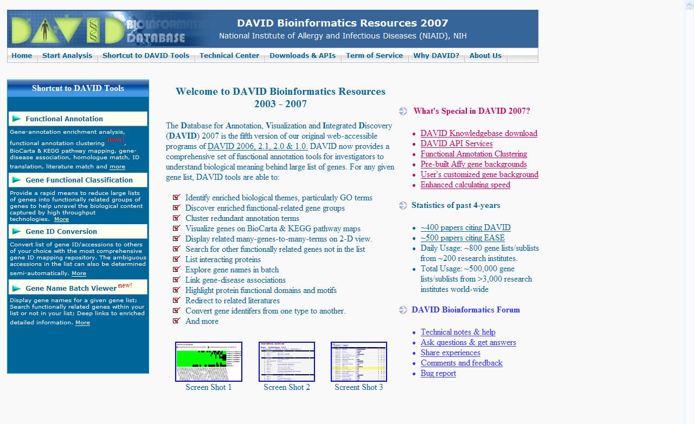
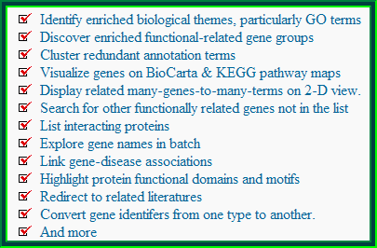
DAVID (http://david.abcc.ncifcrf.gov)
Database for Annotation, Visualization and Integrated Discovery

Slide 41
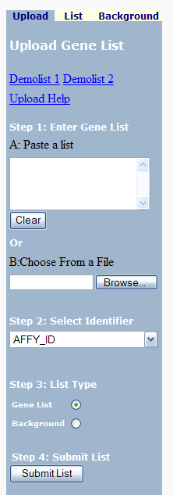
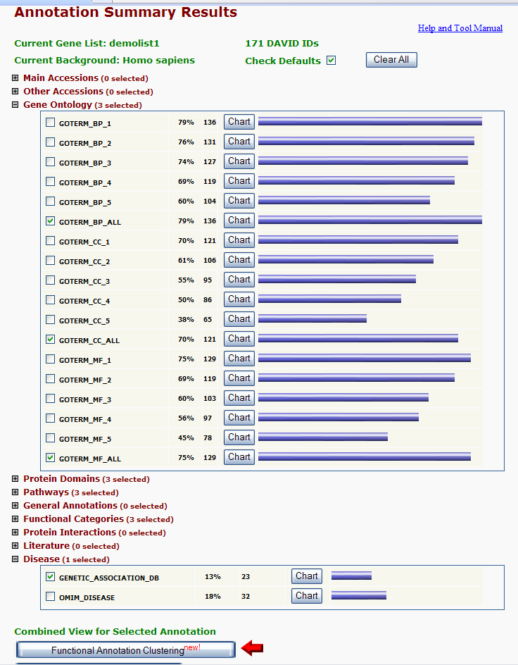
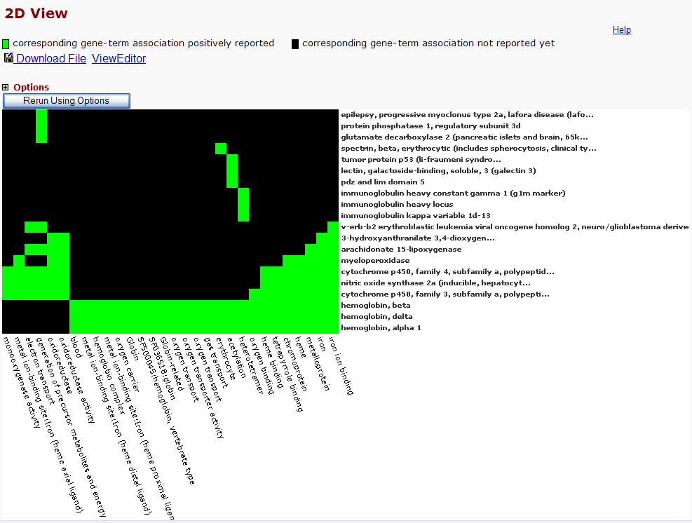
DAVID (http://david.abcc.ncifcrf.gov)

Slide 42
DAVID (http://david.abcc.ncifcrf.gov)

Slide 43
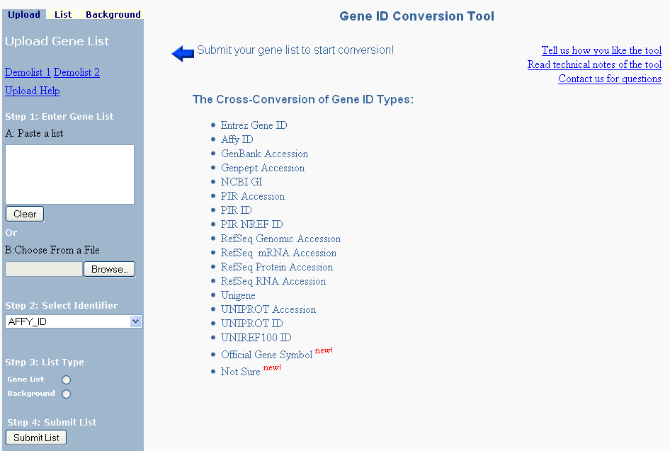
DAVID (http://david.abcc.ncifcrf.gov)
Convert NCBI Entrez Gene IDs to RefSeq Accession Numbers

Slide 44
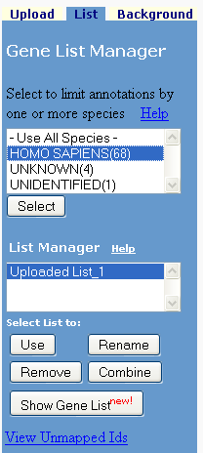
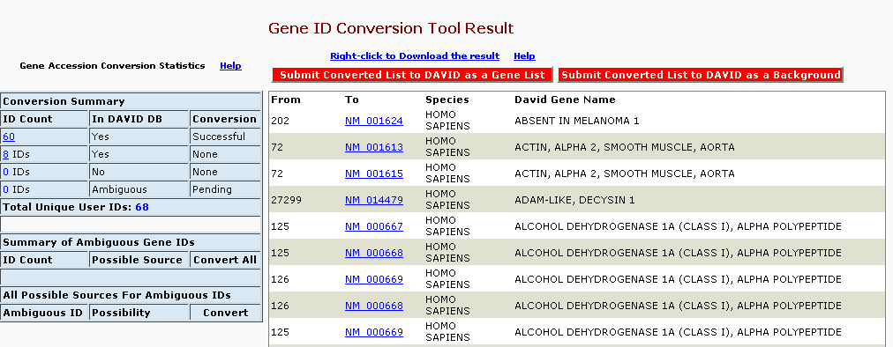
DAVID (http://david.abcc.ncifcrf.gov)

Slide 45
Exercise 4: Convert affymetrix probeset IDs to gene symbols
Exercise 5: What are the enriched pathways and diseases for this gene set? Compare your results with ToppGene.
From the same example data set (“GeneLists.xls”), use the probe set IDs (1st column) and extract their RefSeq accession numbers

Slide 46
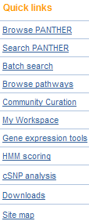
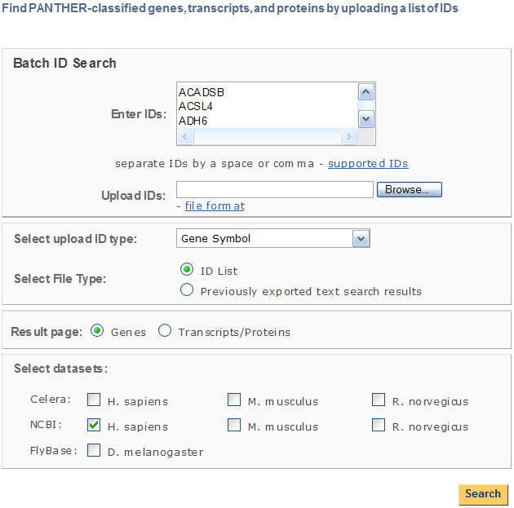
PANTHER (http://www.pantherdb.org/)
Protein ANalysis THrough Evolutionary Relationships
You can compare multiple lists!

Slide 47
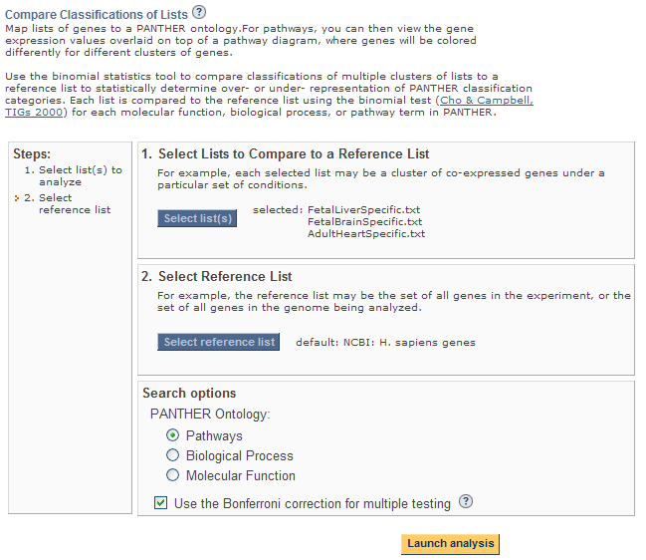
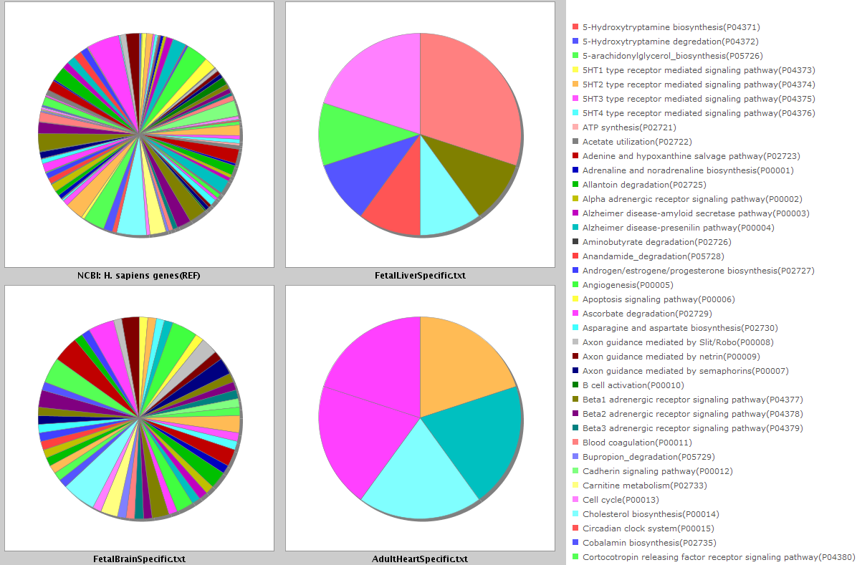

Slide 48
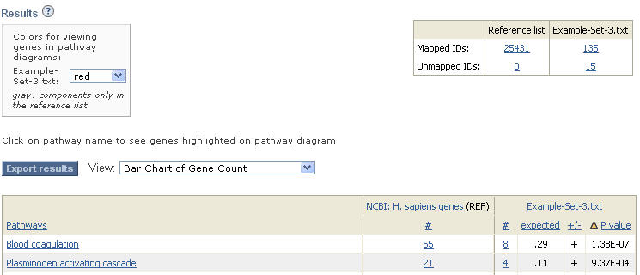
PANTHER (http://www.pantherdb.org/)
Protein ANalysis THrough Evolutionary Relationships

Slide 49
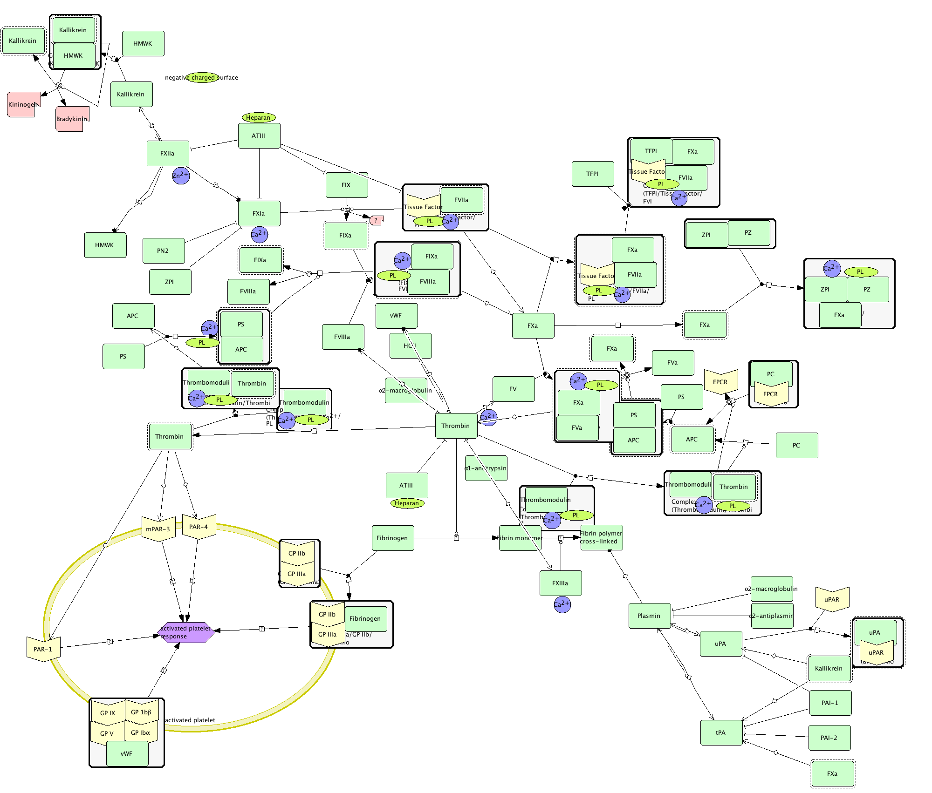
PANTHER (http://www.pantherdb.org/)

Slide 50
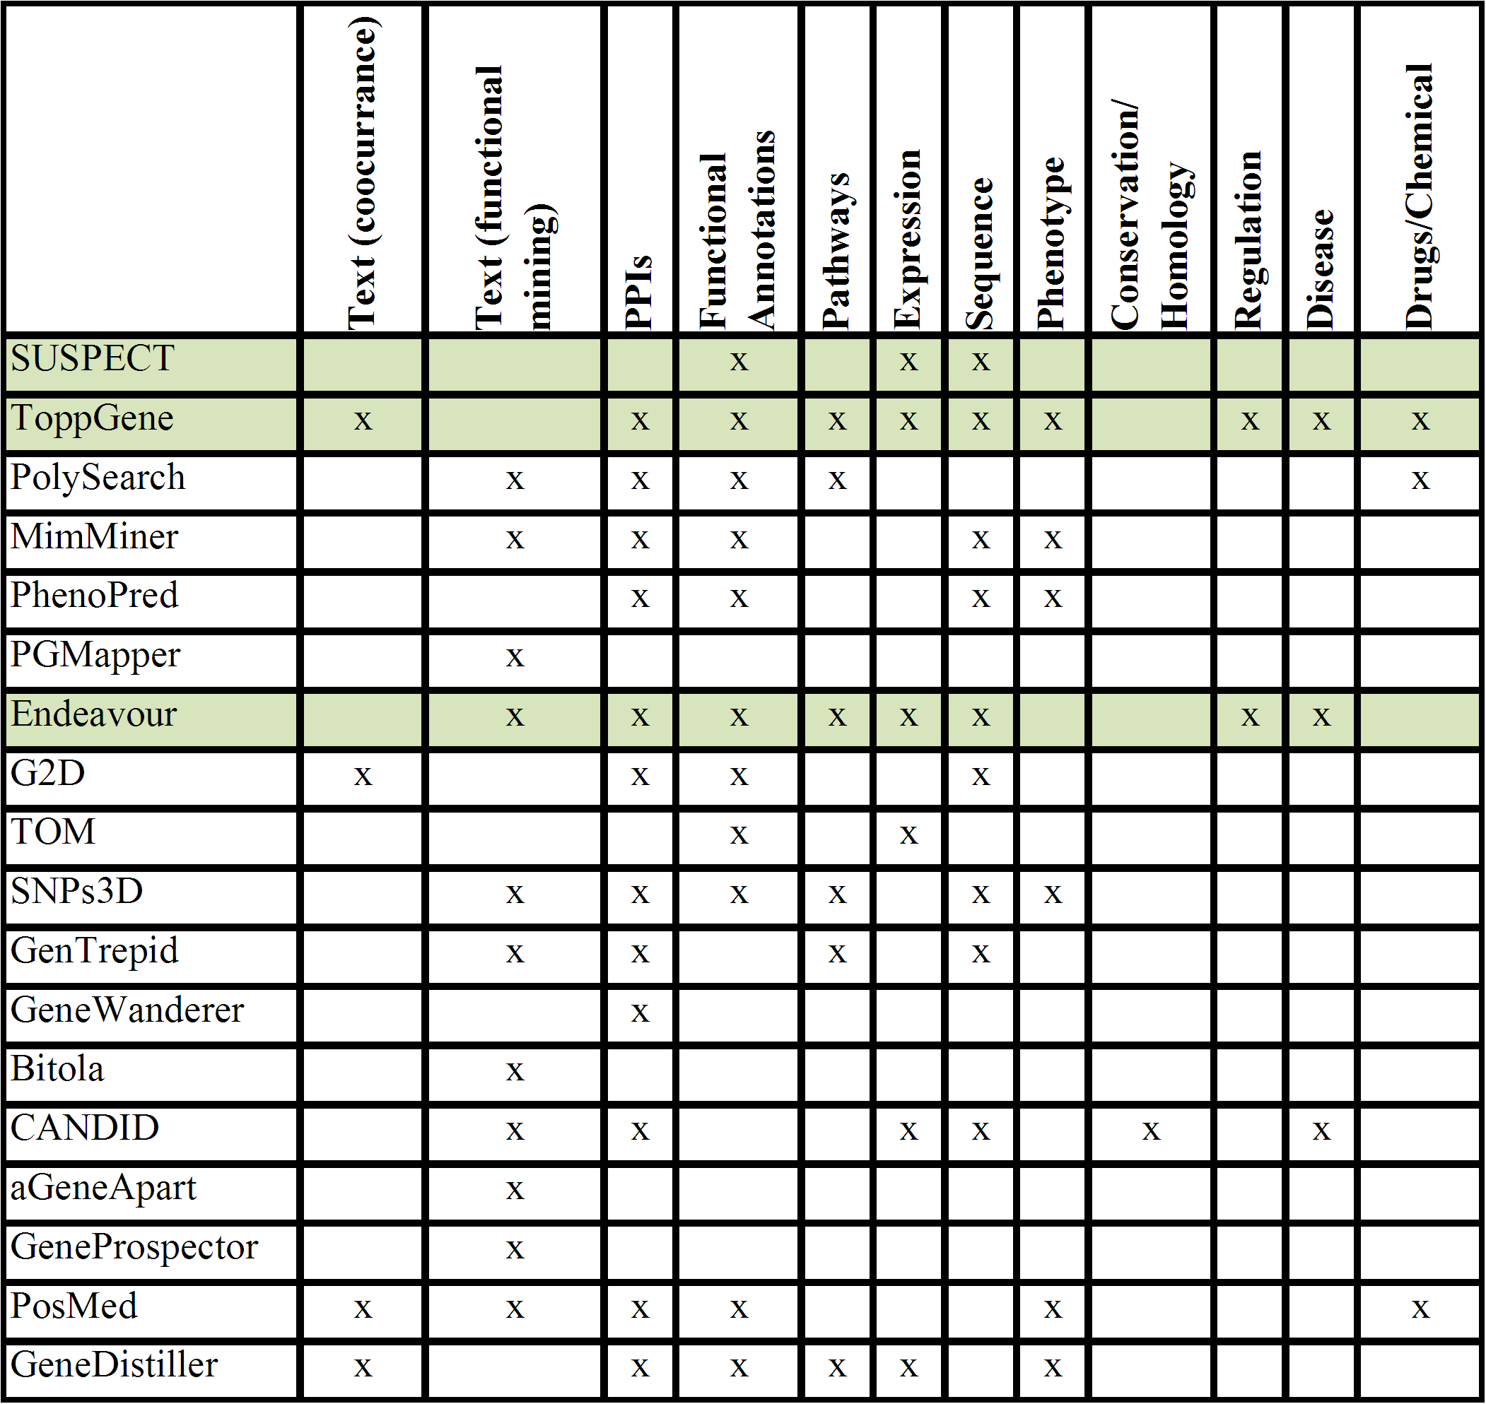
Gene Prioritization Tools
Adapted from Gene Prioritization Portal: http://homes.esat.kuleuven.be/~bioiuser/gpp/index.php

Slide 51
RESOURCES - URLs: Summary
Application/Resource | URL
ToppGene | http://toppgene.cchmc.org
ToppCluster | http://toppcluster.cchmc.org
DAVID | http://david.abcc.ncifcrf.gov
PANTHER | http://www.pantherdb.org

Slide 52
Exercises - Summary
Exercise 1: Use the gene list from the downloaded file (“GeneLists.xls”) and find out:
How many of the liver-overexpressed genes are associated with lipid metabolic process?
Are there any enriched TFBSs for liver overexpressed genes?
What are the enriched miRNAs in the colon-cecum overexpressed genes?
What gene families are enriched in esophagus overexpressed genes?
In which other regions are stomach (cardiac) genes overexpressed?
What biological process are miR-1 target genes enriched for?
Exercise 2: Use the different gene lists from the downloaded file (“GeneLists.xls”) and find out:
What are the shared and specific biological processes between stomach and salivary glands?
Are there any enriched miRNAs for stomach? If so, which other tissues are enriched for this miRNA?
What are the functional similarities and differences between the 3 regions of the stomach (cardiac, fundus, and pylorus)?
Exercise 3: Prioritize the 721 genes (“CandidateGenes”) using “stomach genes” from the “GeneLists.xls”.
What are the top 10 ranked genes using ToppGene and ToppNet?
What is the rank of TFF3 and why is it ranked amongst the top? What is its rank in ToppNet?
Exercise 4: Convert affymetrix probeset IDs to gene symbols
Exercise 5: What are the enriched pathways and diseases for this gene set? Compare your results with ToppGene.
For additional exercises, see http://anil.cchmc.org/dhc.html

