Slide 1
Know Your Transcriptome Integrative Bioinformatic Approaches
Anil Jegga
Biomedical Informatics
Contact Information:
Anil Jegga
Biomedical Informatics
Room # 232, S Building 10th Floor
CCHMC
Homepage: http://anil.cchmc.org
Tel: 513-636-0261
E-mail: anil.jegga@cchmc.org

Slide 2
Slides and Example data sets available for download at:
http://anil.cchmc.org/dhc.html
Workshop Evaluation: Please provide your valuable feedback on the evaluation sheet provided along with the hand-outs
This workshop is about the analysis of transcriptome and does not cover microarray data analysis
Contact Huan Xu (huan.xu@cchmc.org for GeneSpring related questions or microarray data analysis
All the applications/servers/databases used in this workshop are free for academic-use. Applications that are not free for use (e.g. Ingenuity Pathway Analysis, MatInspector, etc.) are not covered here. However, we have licensed access to both of these and please contact us if you are interested in using them.

Slide 3
I have a list of co-expressed mRNAs (Transcriptome)….
Now what?
Identify putative shared regulatory elements
Identify the underlying biological theme
Known transcription factor binding sites (TFBS)
Conserved
Non-conserved
Unknown TFBS or Novel motifs
Conserved
Non-conserved
MicroRNAs
Gene Ontology
Pathways
Phenotype/Disease Association
Protein Domains
Protein Interactions
Expression in other tissues/experiments
Drug targets
Literature co-citation…

Slide 4
Annotation Databases
Gene Ontology, Pathways
Genome-wide Promoters
Putative Regulatory Signatures
Expression Profile - Gene Lists
DNA Repair
XRCC1
OGG1
ERCC1
MPG…..
E2F
RB1
MCM4
FOS
SIVA…..
Angiogenesis
HIF1A
ANGPT1
VEGF
KLF5….
PDX1
GLUT2
PAX4
PDX1
IAPP….
p53
CDKN1A
CTSD
CASP
DDB2….
Gene lists associated with similar function/process/pathway
P53
CTSD
CASP
DDB2….
E2F
RB1
MCM4
FOS…
Enrichment Analysis
DNA Repair
XRCC1
OGG1
ERCC1
MPG….
Angiogenesis
HIF1A
ANGPT1
VEGF…..
Expected
Observed
Random Distribution
Significant Enrichment

Slide 5
I have a list of co-expressed mRNAs (Transcriptome)….
I want to find the shared cis-elements – Known and Novel
Known transcription factor binding sites (TFBS)
Conserved
oPOSSUM
DiRE
Non-conserved
Pscan
MatInspector (*Licensed)
Unknown TFBS or Novel motifs
Conserved
oPOSSUM
Weeder-H
Non-conserved
MEME
Weeder
Each of these applications support different forms of input. Very few support probeset IDs.
Red Font: Input sequence required; Do not support gene symbols, gene IDs, or accession numbers. The advantage is you can use them for scanning sequences from any species.
*Licensed software: We have access to the licensed version.

Slide 6
I have a list of co-expressed mRNAs (Transcriptome)….
I want to find the shared cis-elements – Known and Novel
Known transcription factor binding sites (TFBS)
Conserved
oPOSSUM
DiRE
Non-conserved
Pscan
MatInspector (*Licensed)
Unknown TFBS or Novel motifs
Conserved
oPOSSUM
Weeder-H
Non-conserved
MEME
Weeder

Slide 7
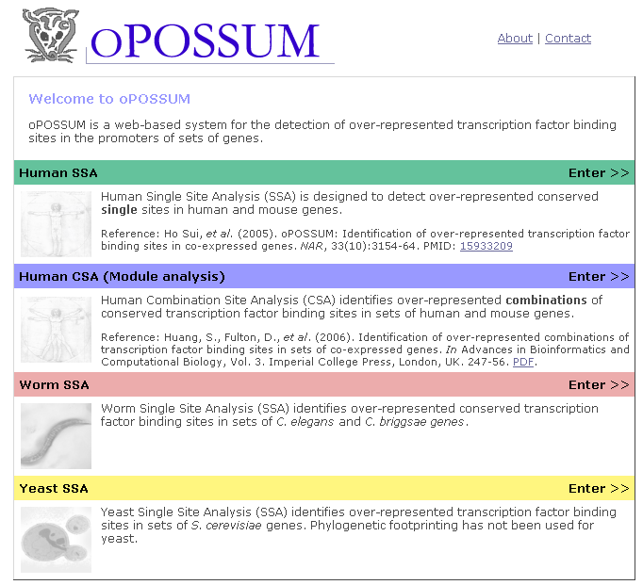
oPOSSUM (http://www.cisreg.ca/oPOSSUM)
Supports human and mouse

Slide 8
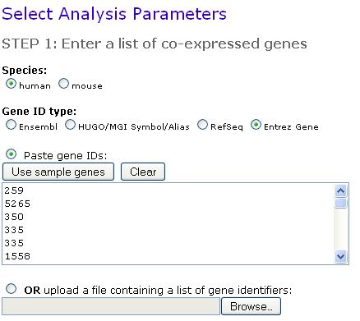
oPOSSUM (http://www.cisreg.ca/oPOSSUM)
Disadvantage: Supports either human or mouse only

Slide 9
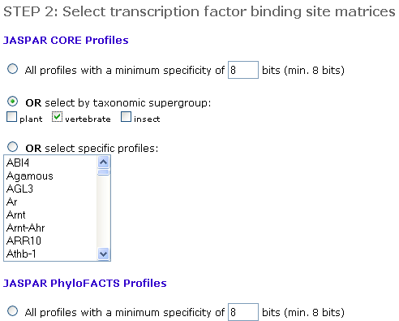
oPOSSUM (http://www.cisreg.ca/oPOSSUM)
The JASPAR PHYLOFACTS database consists of 174 profiles that were extracted from phylogenetically conserved gene upstream elements. They are a mix of known and as of yet undefined motifs.
When should it be used?
They are useful when one expects that other factors might determine promoter characteristics and/or tissue specificity.

Slide 10
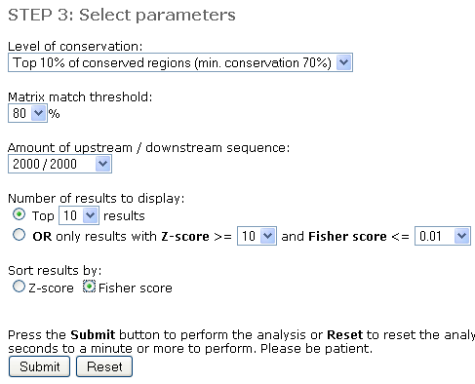
oPOSSUM (http://www.cisreg.ca/oPOSSUM)
The Fisher statistic reflects the proportion of genes that contain the TFBS compared to background.
The Z-score statistic reflects the occurrence of the TFBS in the promoters of the co-expressed set compared to background.

Slide 11
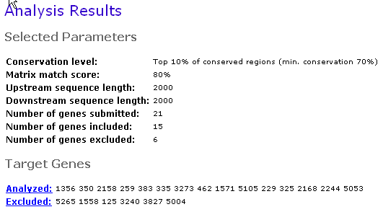
oPOSSUM (http://www.cisreg.ca/oPOSSUM)

Slide 13
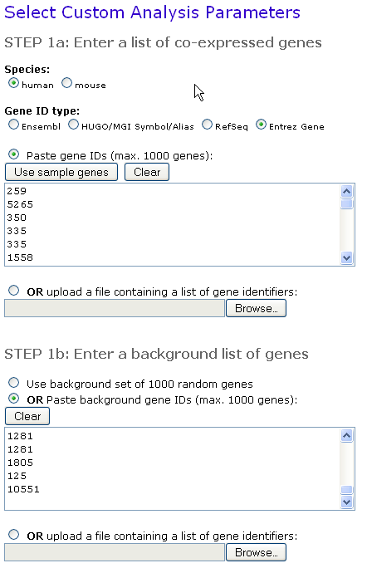
oPOSSUM (http://www.cisreg.ca/oPOSSUM)

Slide 14
Exercise 1: Use oPOSSUM to find shared conserved cis-elements in a group of co-expressed genes
Download the example dataset (file “Example-Set-1.xls” – rt. click and “save as” from http://anil.cchmc.org/dhc.html
Copy 20 or 25 gene IDs from the downloaded file and use them for oPOSSUM analysis
oPOSSUM Summary:
For conserved common cis-elements in a group of genes
Supports human or mouse only
Uses JASPAR matrices only which are not exhaustive
Options to select the regions (max. 10 kb flanking region)
Results indicate the TFBSs’ positions relative to the TSS and the coordinates are from the current genome assembly
Supports selection of background set
Does not support upload of your sequences; Input should be standard gene symbols or IDs or accession numbers

Slide 15
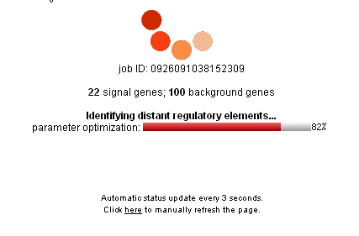
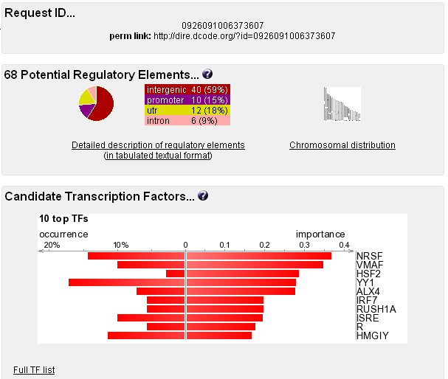
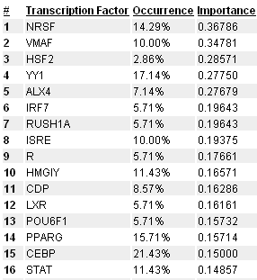
oPOSSUM Summary:
Options to select the regions (max. 10 kb flanking region)
DiRE (http://dire.dcode.org/)

Slide 16
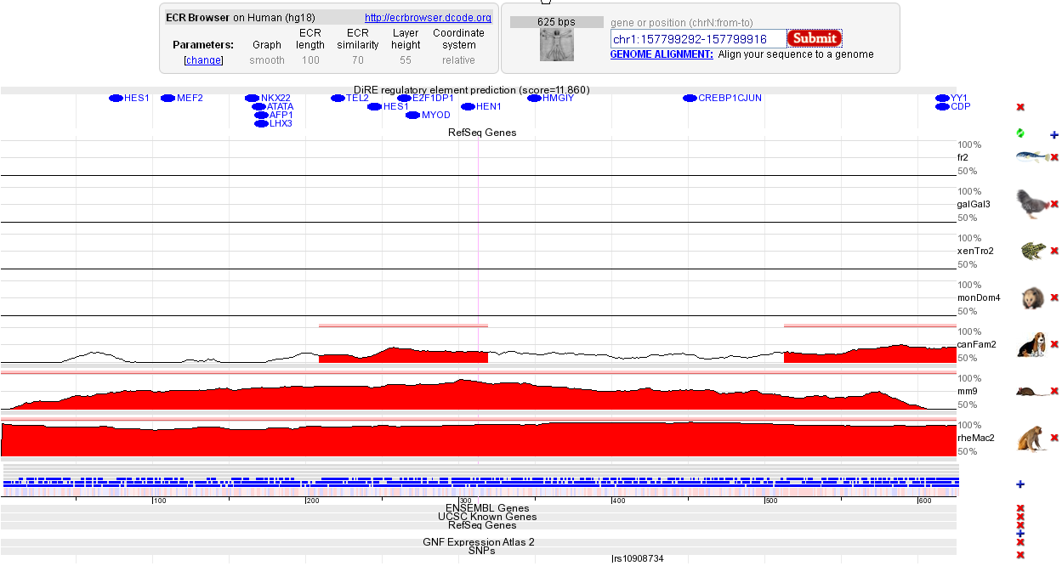
DiRE (http://dire.dcode.org/)
ECR-Browser (http://ecrbrowser.dcode.org/)

Slide 17
Exercise 2: Use DiRE to find shared conserved cis-elements in a group of co-expressed genes
Use the same example dataset (downloaded file “Example-Set-1.xls”) and identify putative distant regulatory regions using DiRE
DiRE Summary:
DiRE's unique feature is the detection of conserved REs outside of proximal promoter regions, as it takes advantage of the full gene locus to conduct the search.
Supports human, mouse, and rat
Uses TRANSFAC matrices which are more exhaustive than JASPAR matrices
Limited options to select the regions for scanning
Results indicate the context (promoter, intronic, or UTR, etc.) and the coordinates are from the current genome assembly
Supports selection of background set
Does not support upload of your sequences; Input should be standard gene symbols or IDs or accession numbers
Connects to genome browser

Slide 18
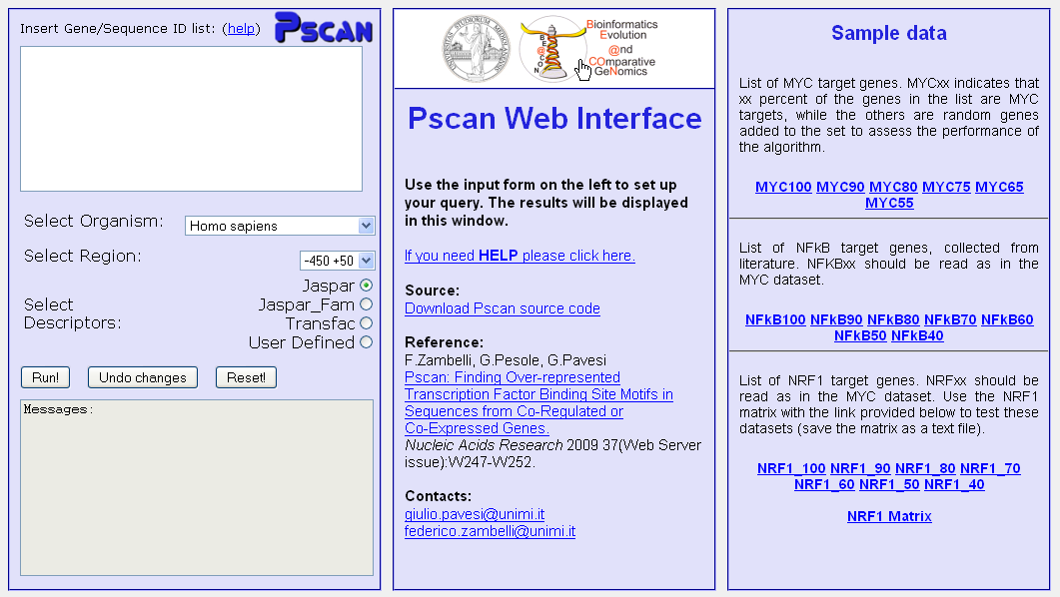
Pscan (http://159.149.109.9/pscan)

Slide 19
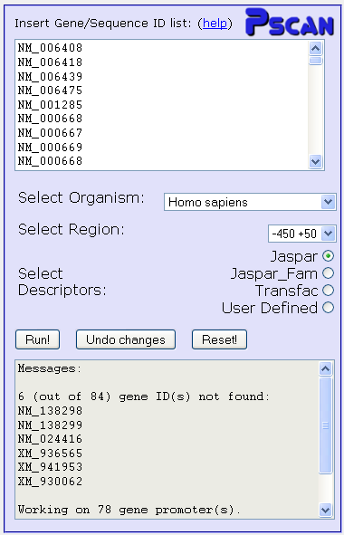
Pscan (http://159.149.109.9/pscan)

Slide 20
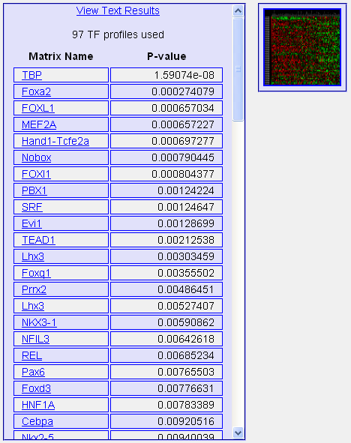
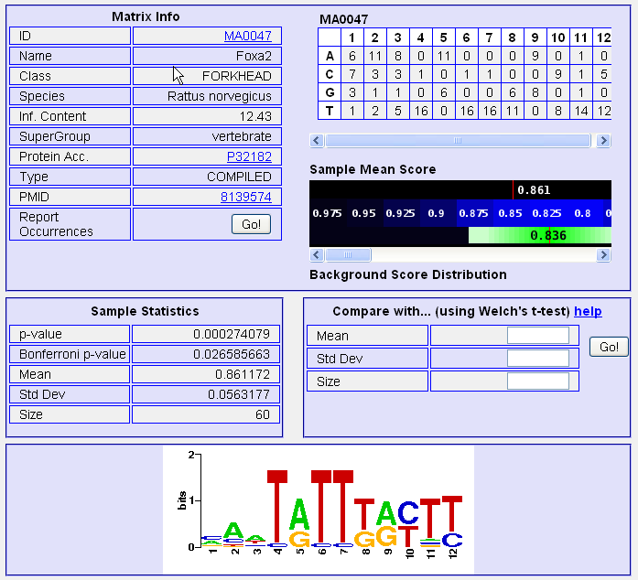
Pscan (http://159.149.109.9/pscan)

Slide 21
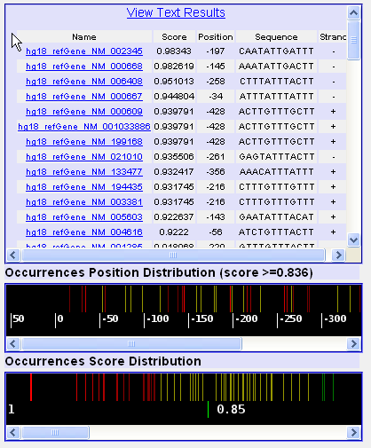
Pscan (http://159.149.109.9/pscan)

Slide 22
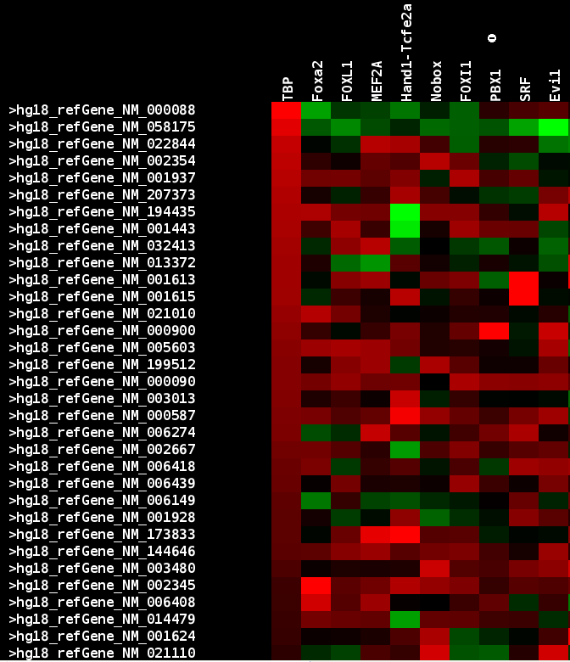
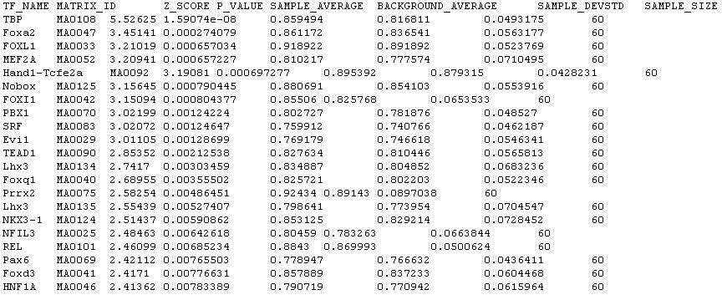
Pscan (http://159.149.109.9/pscan)

Slide 23
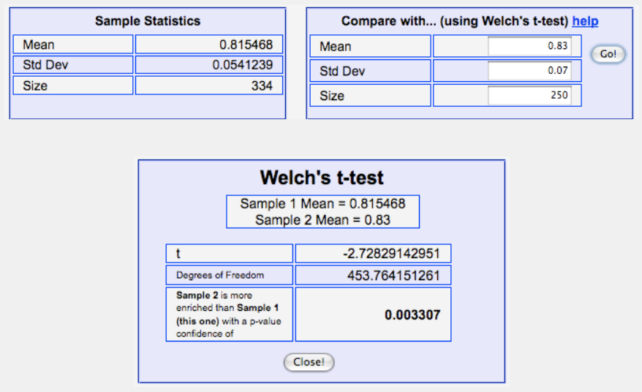
Pscan (http://159.149.109.9/pscan)
Comparing different input gene sets:
In the detailed output for a given matrix, you can compare the results obtained with the matrix on the gene set just submitted with the results the matrix had produced on another gene set. The latter could be a "negative" gene set (or vice versa ).
To perform the comparison, you have to fill in the "Compare with..." box fields with mean, standard deviation and sample size values of the other analysis - for the current one you can find them in the "Sample Data Statistics" box or in the overall text output that can be downloaded from the main output page.
Warning: Make sure that the values you input are correct, and especially that they were obtained by using the same matrix. Once you have clicked the "Go!" button, an output window will pop up and report if either of the two means is significantly higher than the other, together with a confidence p-value computed with a Welch t-test.

Slide 24
Exercise 3: Use Pscan to find shared cis-elements (Transfac) in a group of co-expressed genes
Use the same example data set (downloaded file “Example-Set-1.xls”) and find the enriched JASPAR and Transfac TFBS. How do the outputs differ?
PScan Summary:
Pscan supports a variety of TFBS matrices (e.g. JASPAR, Transfac) including user input matrix.
Supports human, mouse, drosophila, and yeast
Limited options to select the regions for scanning
Cannot select the background set although comparisons can be computed
Does not support upload of your sequences; Input options are very limited
Variety of user-friendly output formats including heat map view

Slide 25
I have a list of co-expressed mRNAs (Transcriptome)….
I want to find the shared cis-elements – Known and Novel
Known transcription factor binding sites (TFBS)
Conserved
oPOSSUM
DiRE
Non-conserved
Pscan
MatInspector (*Licensed)
Unknown TFBS or Novel motifs
Conserved
oPOSSUM
Weeder-H
Non-conserved
MEME
Weeder

Slide 26
oPOSSUM (http://www.cisreg.ca/oPOSSUM)

Slide 27
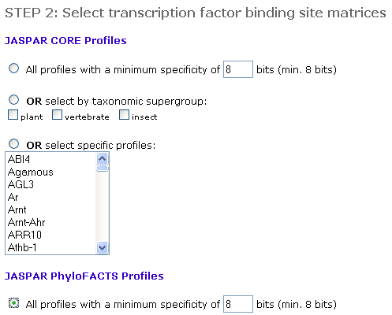
oPOSSUM (http://www.cisreg.ca/oPOSSUM)
The JASPAR PHYLOFACTS database consists of 174 profiles that were extracted from phylogenetically conserved gene upstream elements. They are a mix of known and as of yet undefined motifs.
When should it be used?
They are useful when one expects that other factors might determine promoter characteristics and/or tissue specificity.

Slide 28
oPOSSUM (http://www.cisreg.ca/oPOSSUM)

Slide 29
oPOSSUM (http://www.cisreg.ca/oPOSSUM)

Slide 30
I have a list of co-expressed mRNAs (Transcriptome)….
I want to find the shared cis-elements – Known and Novel
Known transcription factor binding sites (TFBS)
Conserved
oPOSSUM
DiRE
Non-conserved
Pscan
MatInspector (*Licensed)
Unknown TFBS or Novel motifs
Conserved
oPOSSUM
Weeder-H
Non-conserved
MEME
Weeder
Each of these applications support different forms of input. Very few support probeset IDs.
Red Font: Input sequence required; Do not support gene symbols, gene IDs, or accession numbers. The advantage is you can use them for scanning sequences from any species.
*Licensed software: We have access to the licensed version.
How to fetch promoter/upstream sequence – single/multiple?

Slide 31
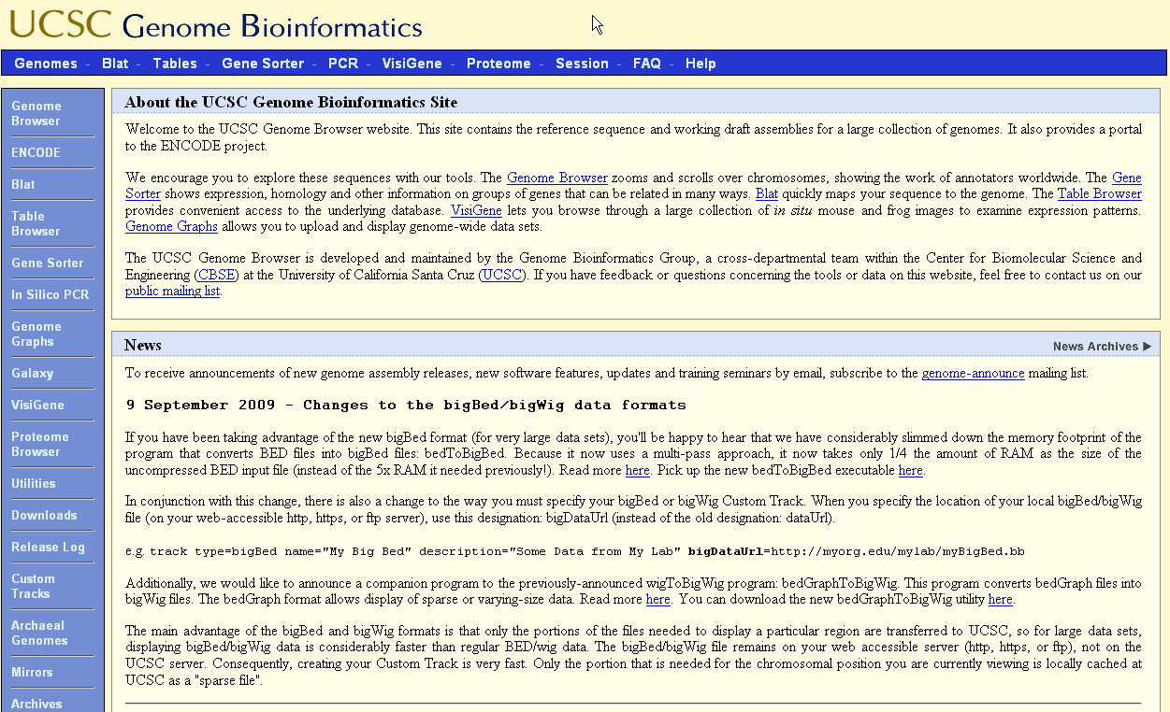
Genome Browser (http://genome.ucsc.edu)

Slide 32
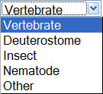
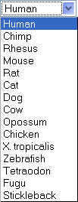
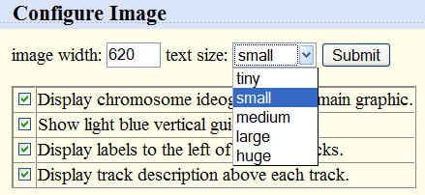
Genome Browser (http://genome.ucsc.edu)
1
2
3
4
5
6
Genome Browser Gateway choices:
Select Clade
Select genome/species: You can search only one species at a time
Assembly: the official backbone DNA sequence
Position: location in the genome to examine or search term (gene symbol, accession number, etc.)
Image width: how many pixels in display window; 5000 max
Configure: make fonts bigger + other options

Slide 33
Genome Browser (http://genome.ucsc.edu)

Slide 34
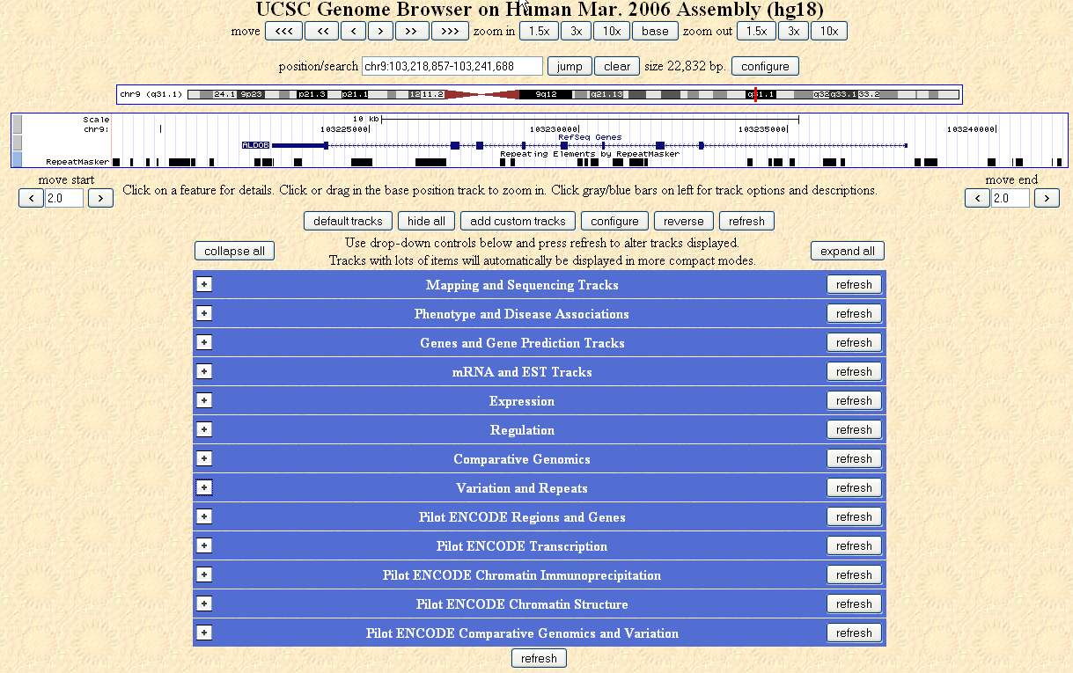
Genome Browser (http://genome.ucsc.edu)
Explore the tracks

Slide 35
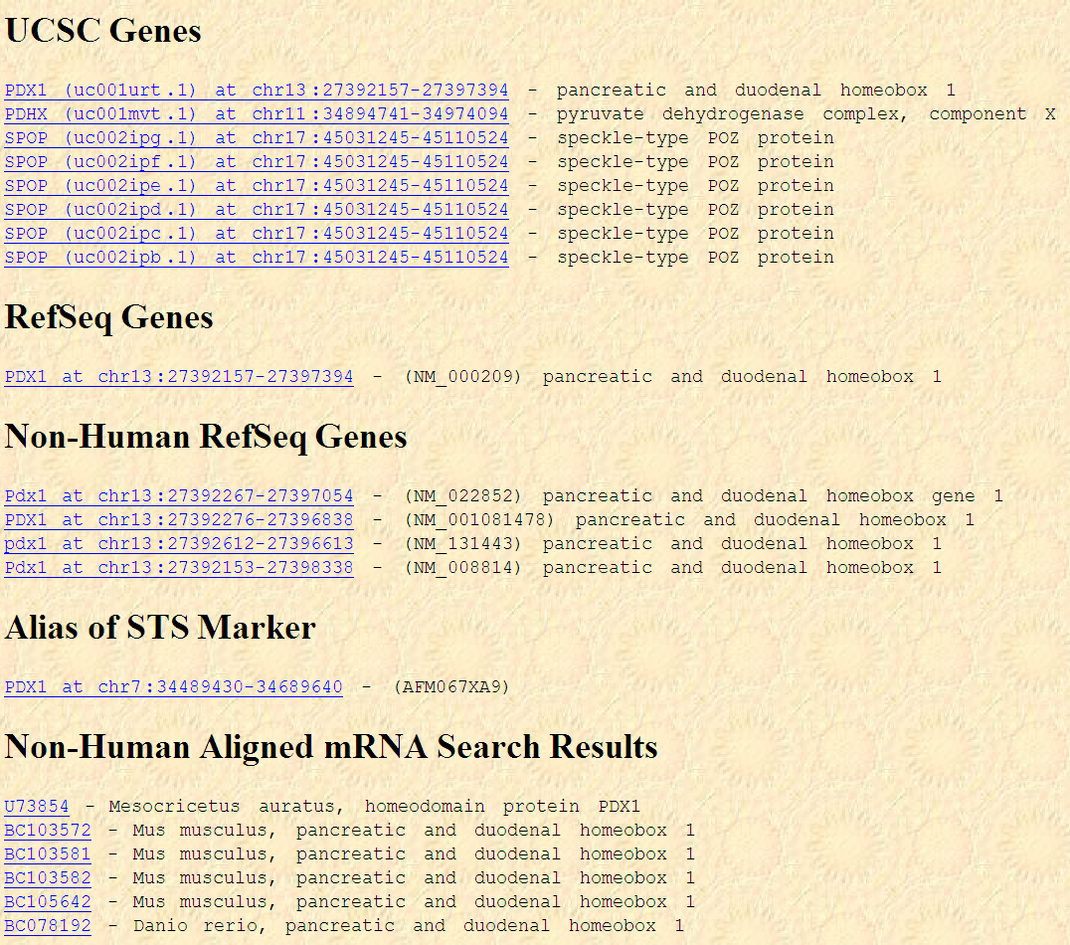
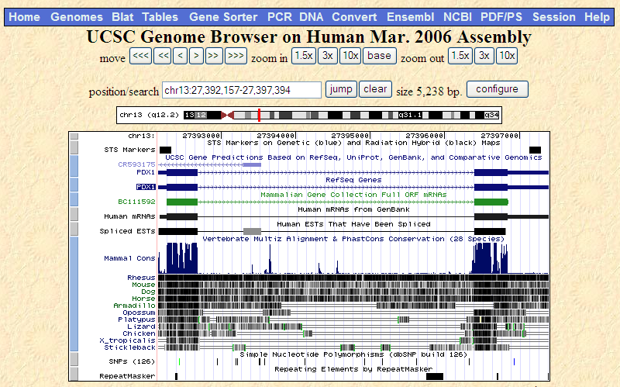
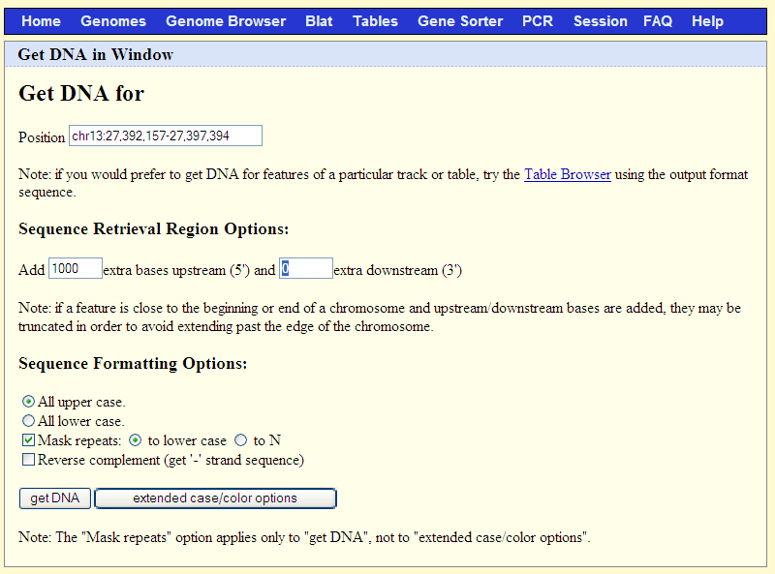
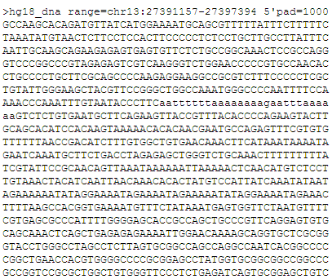

Slide 36
Genome Browser (http://genome.ucsc.edu)

Slide 37
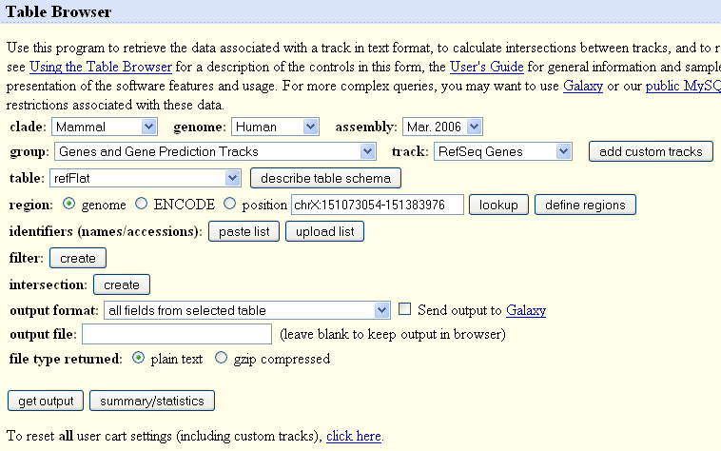
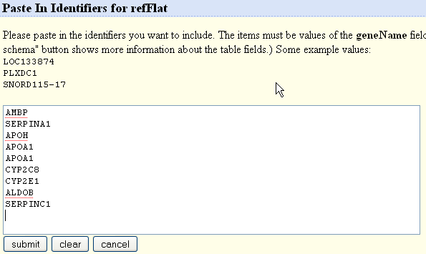
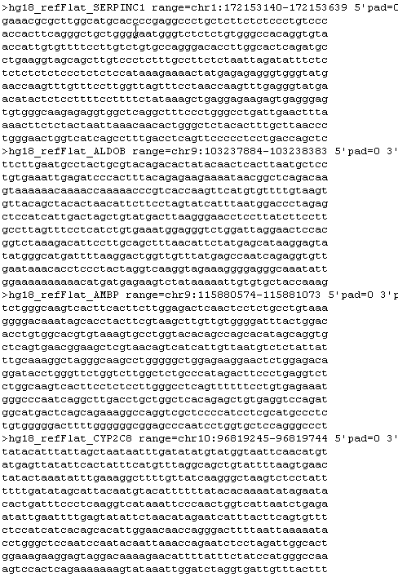
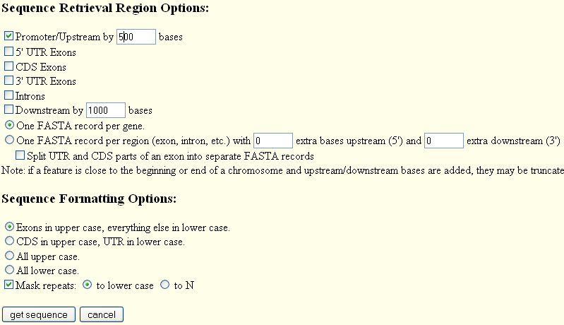
Genome Browser (http://genome.ucsc.edu)
1
2
3
6
4
5

Slide 38
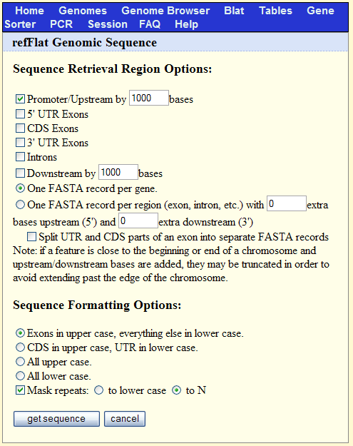
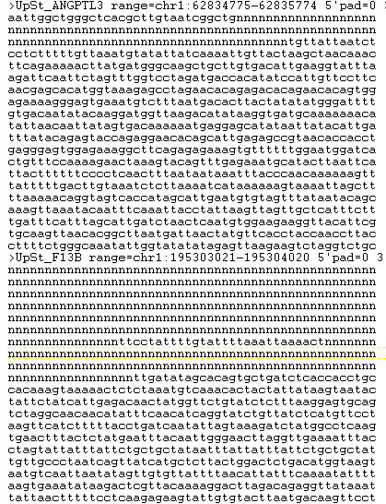

Slide 39
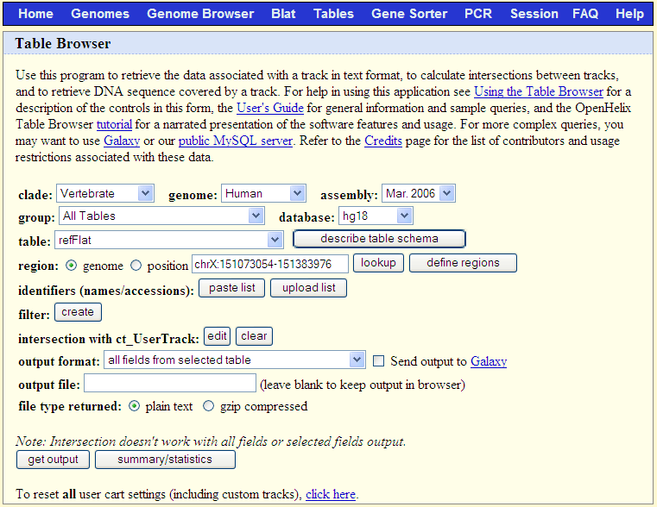
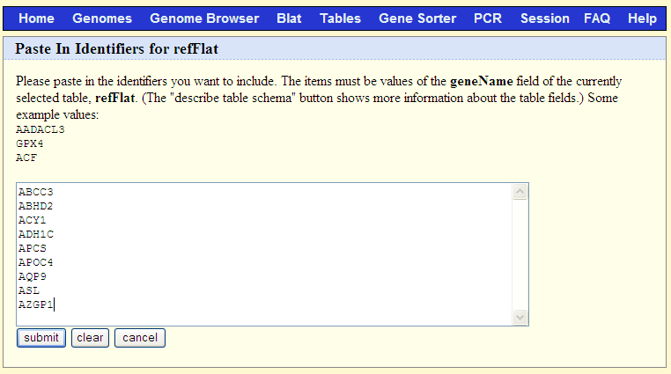
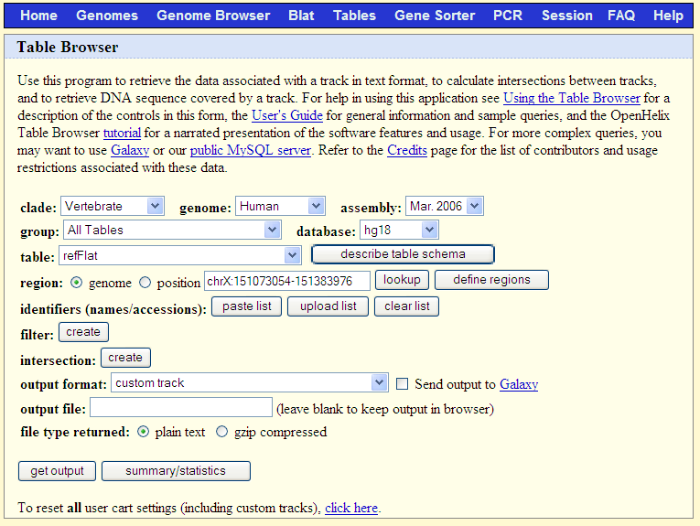
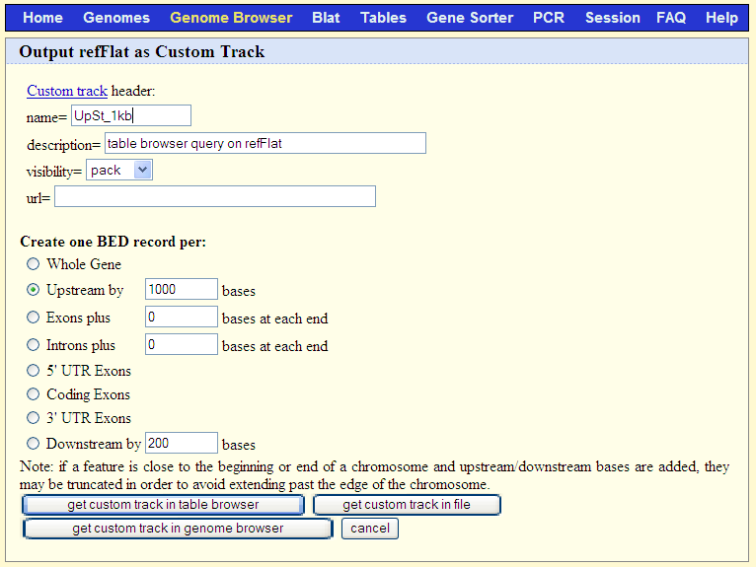
1
Paste the gene symbols
Remember it is case-sensitive:
Human: all upper case (e.g. XRCC1)
Mouse: lower case (first letter upper case. E.g. Xrcc1)
2
Select “refFlat” under “table”
Ensure that “region” is “genome”
Click on “paste list”
Describe your track
4
3
Enter number of bp you want to analyze/download
Select the output format as “custom track”

Slide 40
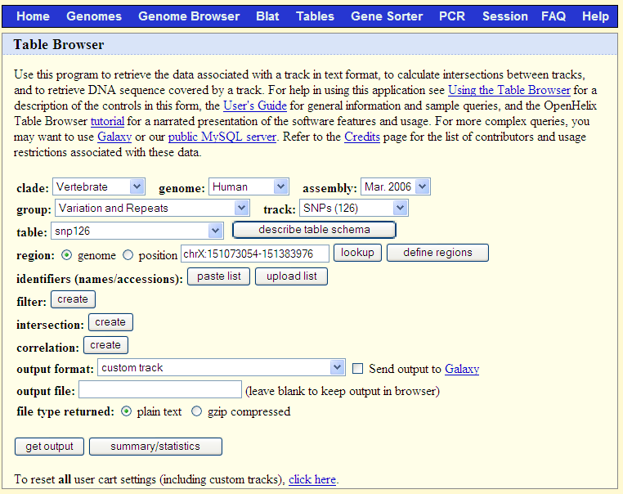
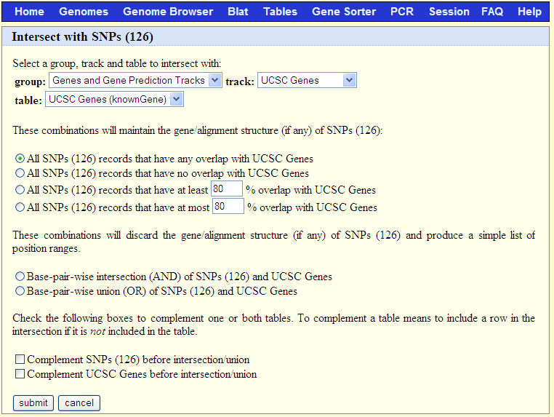
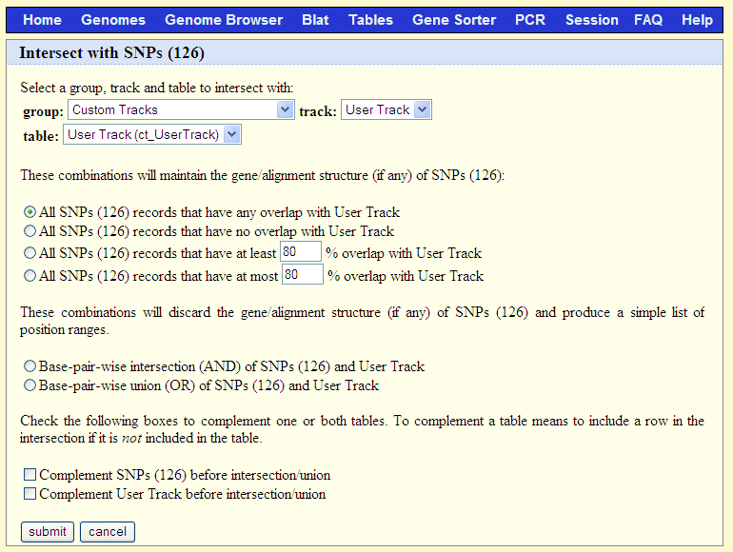
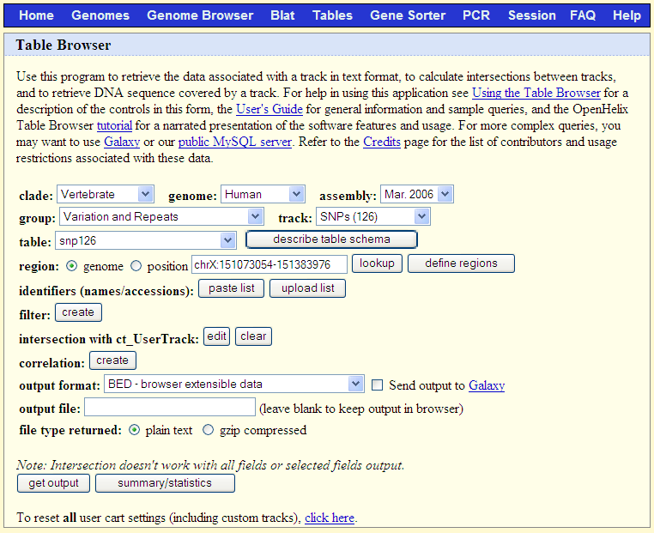
6
5
Select “Variation and Repeats” under “Group”
Click on “create” under “intersection”
Change the “group” to “Custom Tracks” and select the appropriate “track” and “table”
7
8
Try GTF output too

Slide 41
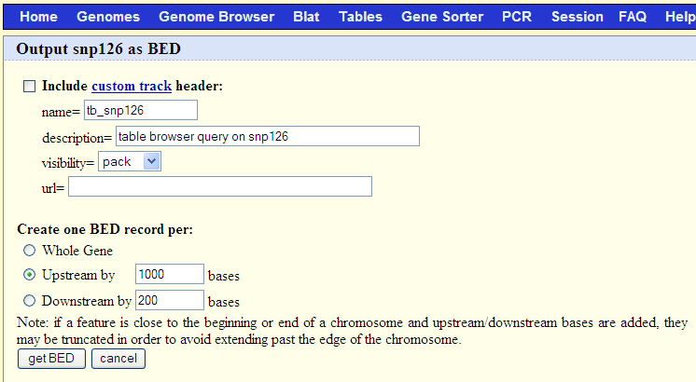
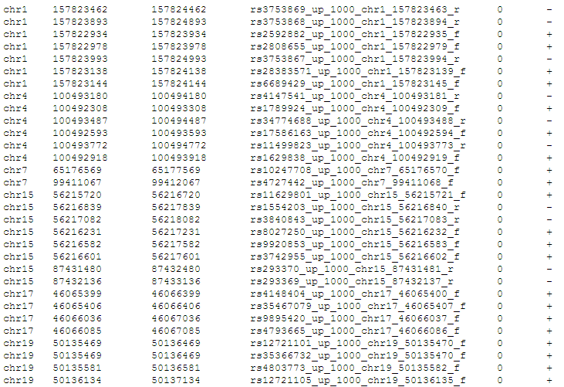
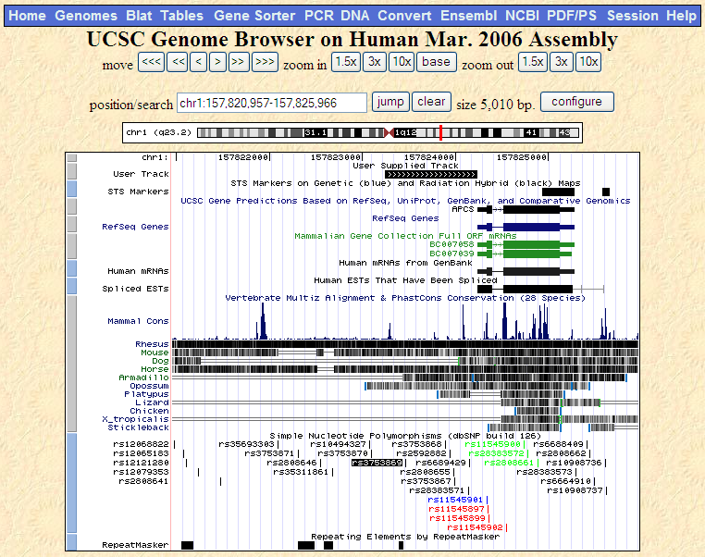
9
10
Genome Browser view that lists all the SNPs lying within the upstream 1 kb (the region we queried) region of one of the genes analyzed.
One drawback with this output is it doesn’t tell you which SNPs are in the upstream region of which gene. However, since the positions of SNPs are included, you can compare them with the gene coordinates and figure it out .

Slide 42
Exercise 4: Download upstream 500 bp sequence for a list of genes (use the same list as before).
Exercise 5: Download all SNPs overlapping with these genes.
Exercise 6: Download the orthologous promoter sequences (human, mouse, and rat) for the gene SLC7A1.
Exercise 7: Are their any putative microRNA regulators for SLC7A1? If yes, download all of them using table browser.

Slide 43
I have a list of co-expressed mRNAs (Transcriptome)….
I want to find the shared cis-elements – Known and Novel
Known transcription factor binding sites (TFBS)
Conserved
oPOSSUM
DiRE
Non-conserved
Pscan
MatInspector (*Licensed)
Unknown TFBS or Novel motifs
Conserved
oPOSSUM
Weeder-H
Non-conserved
MEME
Weeder
Each of these applications support different forms of input. Very few support probeset IDs.
Red Font: Input sequence required; Do not support gene symbols, gene IDs, or accession numbers. The advantage is you can use them for scanning sequences from any species.
*Licensed software: We have access to the licensed version.
Use the fetched promoter/upstream sequences for the following analyses

Slide 44
WeederH (http://159.149.109.9/pscan)
Supports large number of species.
Does not support multiple sequences (multifasta) input. You have to enter each sequence separately.
Good for small number of sequences where you expect a potential novel (or not included in the TFBS libraries) conserved motif.

Slide 45
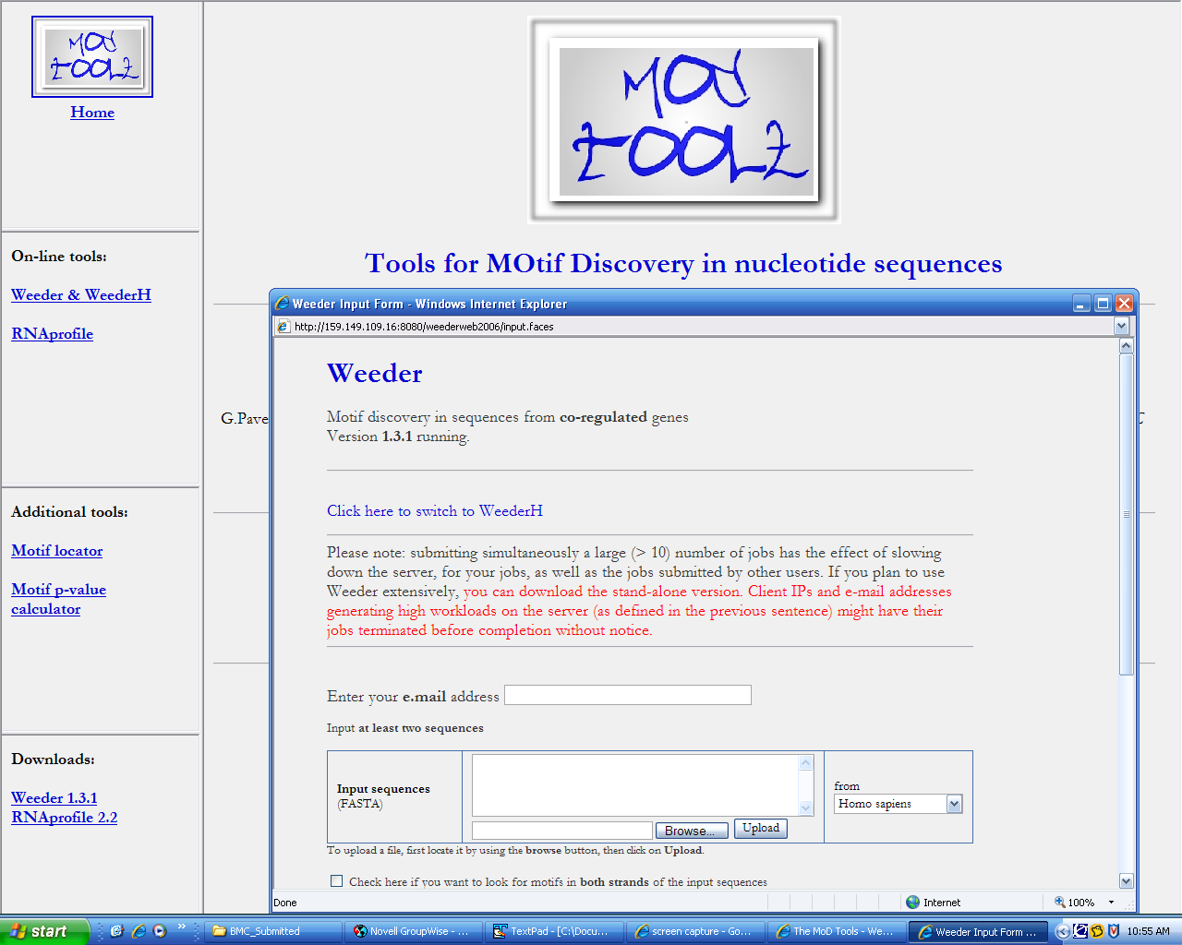
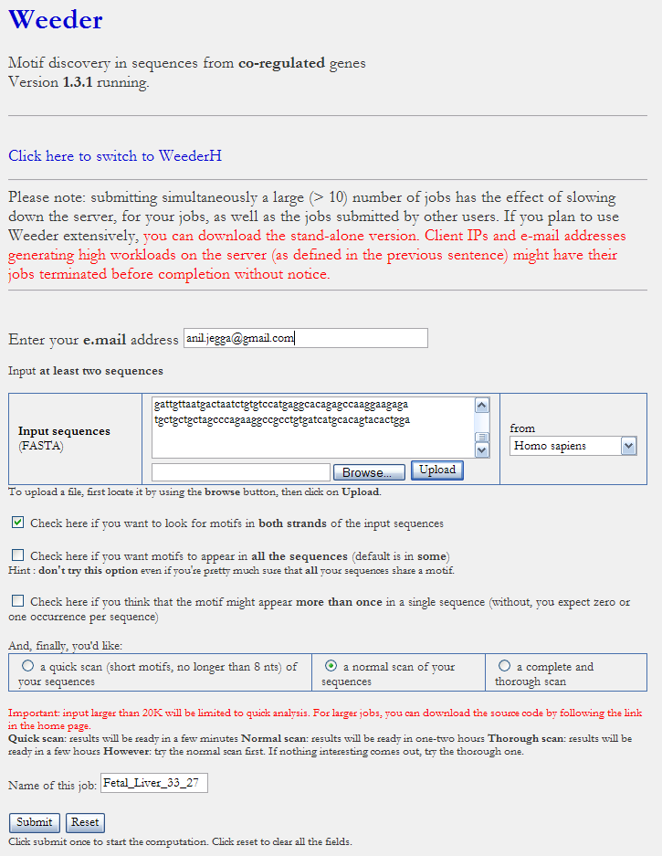
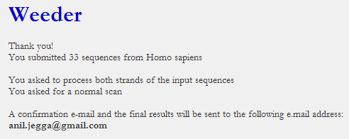
Weeder (http://159.149.109.9:8080/weederweb2006)
Do not use Groupwise mail when submitting large number of sequences because the results are sent “in the mail” and not as an attachment. And Groupwise mail truncates messages if they are very long. Use Gmail instead. A link to the results page used to be sent earlier.

Slide 46
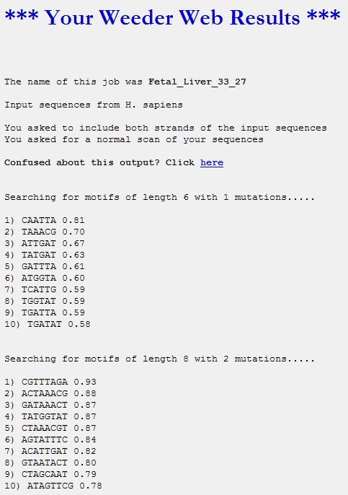
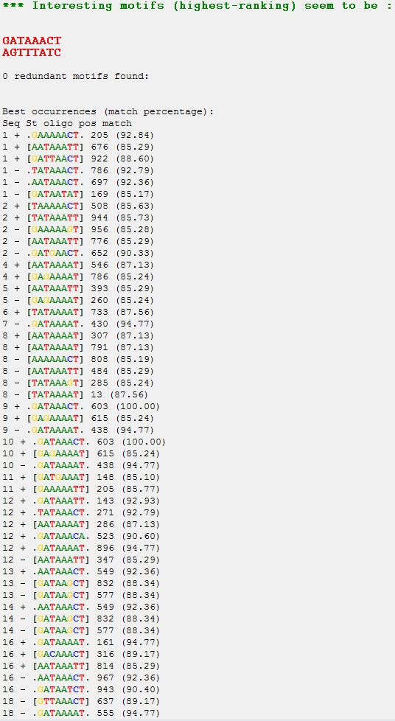
Weeder (http://159.149.109.9:8080/weederweb2006)

Slide 47
MEME (http://meme.sdsc.edu)
MEME takes as input a group of DNA or protein sequences and outputs as many motifs as requested. MEME uses statistical modeling techniques to automatically choose the best width, number of occurrences, and description for each motif.
Your MEME results consist of:
your MEME results in HTML format
your MEME results in XML format
your MEME results in TEXT format
and the MAST results of searching your input sequences for the motifs found by MEME using MAST.

Slide 48
MEME (http://meme.sdsc.edu)

Slide 49
MEME (http://meme.sdsc.edu)
TOMTOM can be used to find out if an overrepresented motif in your sequences matches or is similar to a known TFBS

Slide 50
Exercise 8: Use the downloaded SLC7A1 ortholog promoter sequences to find out common motifs using WeederH
Exercise 9: Use the downloaded promoter sequences (from Exercise 4) to find out common motifs using Weeder and MEME
Exercise 10: Does any of the motifs found by Meme match known TFBS?

Slide 51
I have found a miRNA enriched in my gene list or I am interested in a specific gene and I want to identify putative regulatory regions for miRNA/gene
GenomeTrafac: http://genometrafac.cchmc.org

Slide 52
GenomeTrafac: http://genometrafac.cchmc.org

Slide 53
GenomeTrafac: http://genometrafac.cchmc.org

Slide 54
GenomeTrafac: http://genometrafac.cchmc.org

Slide 55
GenomeTrafac: http://genometrafac.cchmc.org

Slide 56
GenomeTrafac: http://genometrafac.cchmc.org

Slide 57
I have a list of co-expressed mRNAs (Transcriptome)….
Now what?
Identify putative shared regulatory elements
Identify the underlying biological theme
Known transcription factor binding sites (TFBS)
Conserved
Non-conserved
Unknown TFBS or Novel motifs
Conserved
Non-conserved
MicroRNAs
Gene Ontology
Pathways
Phenotype/Disease Association
Protein Domains
Protein Interactions
Expression in other tissues/experiments
Drug targets
Literature co-citation…

Slide 58
ToppGene Suite (http://toppgene.cchmc.org)

Slide 59
ToppGene Suite (http://toppgene.cchmc.org)
Supports variety of inputs
Supports symbol correction
Eliminates any duplicates
Drawback: Supports human and mouse genes only

Slide 60
ToppGene Suite (http://toppgene.cchmc.org)
Gene list analyzed for as many as 17 features!
Single-stop enrichment analysis server for both regulatory elements (TFBSs and miRNA) and biological themes
Back-end has an exhaustive, normalized data resources compiled and integrated
Bonferroni correction is “too stringent”; FDR with 0.05 is preferable.
TFBS are based on conserved cis-elements and motifs within ±2kb region of TSS in human, mouse, rat, and dog.
miRNA-targets are based on TargetScan and PicTar

Slide 61
ToppGene Suite (http://toppgene.cchmc.org)
Database updated regularly
Exhaustive collection of annotations

Slide 62
ToppGene Suite (http://toppgene.cchmc.org)

Slide 63
ToppGene Suite (http://toppgene.cchmc.org)

Slide 64
ToppGene Suite (http://toppgene.cchmc.org)

Slide 65
ToppGene Suite (http://toppgene.cchmc.org)
I have a list of 200 over-expressed genes and I want to prioritize them for experimental validation (apart from using the fold change as a parameter)…..

Slide 66
ToppGene Suite (http://toppgene.cchmc.org)
I have a list of 200 over-expressed genes and I want to prioritize them for experimental validation (apart from using the fold change as a parameter)…..

Slide 67
ToppGene Suite (http://toppgene.cchmc.org)

Slide 68
ToppGene Suite (http://toppgene.cchmc.org)

Slide 69
ToppGene Suite (http://toppgene.cchmc.org)

Slide 70
ToppGene Suite (http://toppgene.cchmc.org)

Slide 71
ToppGene Suite (http://toppgene.cchmc.org)
Why is a test set gene ranked higher?

Slide 72
ToppGene Suite (http://toppgene.cchmc.org)
I have a list of 200 over-expressed genes and I want to prioritize them for experimental validation (apart from using the fold change as a parameter)…..

Slide 73
ToppGene Suite (http://toppgene.cchmc.org)

Slide 74
ToppGene Suite (http://toppgene.cchmc.org)

Slide 75
Exercise 11: Use the gene list from the downloaded file (“Example-Set-2”) and find out:
How many of these genes are transcription factors?
What are the enriched TFBSs and miRNAs?
What gene families are enriched in this list?
Are there are salivary gland development associated genes present in this list?
How many and which genes from this list are associated with non-insulin dependent diabetes mellitus (NIDDM)?
Exercise 12: Prioritize the 721 genes (“Example-Set-2”) using “stomach genes” from the “Example-Set-1”.
What are the top 10 ranked genes using ToppGene and ToppNet?
Why is TFF3 ranked among the top 5 in ToppGene prioritization? What is its rank in ToppNet?

Slide 76
What if I want to compare several gene lists at a time?
ToppCluster (http://toppcluster.cchmc.org)

Slide 77
ToppCluster (http://toppcluster.cchmc.org)

Slide 78
ToppCluster (http://toppcluster.cchmc.org)

Slide 79
ToppCluster (http://toppcluster.cchmc.org)
EHF
COL15A1
LOC100130100
IGHA1
LTF
IGKC
IGL@
FAM129A
ATP8B1
IGLC2
Network View – Shared and specific genes and annotations between different gene lists
Cytoscape (http://cytoscape.org) installation required
V$HNF1
Liver
abnormal gastric mucosa morphology
abnormal stomach morphology
abnormal digestive secretion
abnormal digestive system physiology
Salivary Gland
Stomach

Slide 80
DAVID (http://david.abcc.ncifcrf.gov)
Database for Annotation, Visualization and Integrated Discovery

Slide 81
DAVID (http://david.abcc.ncifcrf.gov)

Slide 82
DAVID (http://david.abcc.ncifcrf.gov)

Slide 83
DAVID (http://david.abcc.ncifcrf.gov)
Convert NCBI Entrez Gene IDs to RefSeq Accession Numbers

Slide 84
DAVID (http://david.abcc.ncifcrf.gov)

Slide 85
Exercise 13: Convert affymetrix probeset IDs to gene symbols
Exercise 14: What are the enriched pathways and diseases for this gene set?
From the same example data set (“Example-Set-1.xls”), use the probe set IDs (2nd column) and extract their RefSeq accession numbers

Slide 86
PANTHER (http://www.pantherdb.org/)
Protein ANalysis THrough Evolutionary Relationships
You can compare multiple lists!

Slide 88
PANTHER (http://www.pantherdb.org/)
Protein ANalysis THrough Evolutionary Relationships

Slide 89
PANTHER (http://www.pantherdb.org/)

Slide 90
Summary
Cis-Element Finding Matrix
 | CONSERVED | NON-CONSERVED
KNOWN TFBS | oPOSSUM DiRE | Pscan MatInspector*
NOVEL/UNKNOWN TFBS OR MOTIFS | oPOSSUM WEEDER-H | MEME WEEDER

Slide 91
RESOURCES - URLs: Summary
Application/Resource | URL
oPOSSUM | http://burgundy.cmmt.ubc.ca/oPOSSUM/
DiRE | http://dire.dcode.org/
Weeder-H | http://159.149.109.9/modtools/
Weeder | http://159.149.109.9/modtools/
Pscan | http://159.149.109.9/modtools/
MEME | http://meme.sdsc.edu/
MatInspector | http://www.genomatix.de/
GenomeTrafac | http://genometrafac.cchmc.org
ToppGene | http://toppgene.cchmc.org
ToppCluster | http://toppcluster.cchmc.org
DAVID | http://david.abcc.ncifcrf.gov
PANTHER | http://www.pantherdb.org
Genome Browser | http://genome.ucsc.edu
ECR Browser | http://ecrbrowser.dcode.org
Slides/Exercises | http://anil.cchmc.org/dhc.html

Slide 92
Exercises - Summary
Exercise 1: Use oPOSSUM to find shared conserved cis-elements in a group of co-expressed genes
Exercise 2: Use DiRE to find shared conserved cis-elements in a group of co-expressed genes
Exercise 3: Use Pscan to find shared cis-elements (Transfac) in a group of co-expressed genes
Exercise 4: Download upstream 500 bp sequence for a list of genes
Exercise 5: Download all SNPs overlapping with these genes
Exercise 6: Download the orthologous promoter sequences (human, mouse, and rat) for the gene SLC7A1
Exercise 7: Are their any putative microRNA regulators for SLC7A1? If yes, download all of them using table browser
Exercise 8: Use the downloaded SLC7A1 ortholog promoter sequences to find out common motifs using WeederH
Exercise 9: Use the downloaded promoter sequences to find out common motifs using Weeder and MEME
Exercise 10: Does any of the motifs found by Meme match known TFBS?
Exercise 11: Use the gene list from the downloaded file (“Example-Set-2”) and find out:
How many of these genes are transcription factors?
What are the enriched TFBSs and miRNAs?
What gene families are enriched in this list?
Are there are salivary gland development associated genes present in this list?
How many and which genes from this list are associated with non-insulin dependent diabetes mellitus (NIDDM)?
Exercise 12: Prioritize the 721 genes (“Example-Set-2”) using “stomach genes” from the “Example-Set-1”.
What are the top 10 ranked genes using ToppGene and ToppNet?
Why is TFF3 ranked among the top 5 in ToppGene prioritization? What is its rank in ToppNet?
Exercise 13: Convert Affymetrix probeset IDs to gene symbols
Exercise 14: What are the enriched pathways and diseases for this gene set?
For additional exercises, see http://anil.cchmc.org/dhc.html

